Slide 1
“Corporate Social Responsibility Committee: International Evidence”
3rd September 2024
GRASFI
Jenny Chu (University of Cambridge)
Xi Li (London School of Economics and Political Science)
Yuxia (Sarine) Zou (Nanyang Technological University)
Notes:
Extensive re-writing stage, any questions/feedback/comments are very welcome.

Slide 2
Motivation and Research Questions
Theoretical
Research on corporate social responsibility (CSR) predominantly examines external disclosure.
Less is understood on the internal governance and management of CSR issues.
Growing trend of firms voluntarily adopting board-level CSR committees – 8.5% in 2002 to 10.6% in 2018 among public firms.
Research Questions
What types of firms voluntarily create separate CSR committees on their corporate boards?
Are CSR committees associated with observable changes in CSR outcomes?
Practical
Lack of regulatory consensus on whether to mandate board-level CSR committees.
Notes:
Why would we like to focus on CSR committees?
So far, the mostly widely taken measure by firms is CSR reporting (almost 100%, 96% of top 250 firms around the world), also most scrutinised by academics.

Slide 3
Overview
Sample and Data
What types of firms voluntarily create separate CSR committees on their corporate boards
Are CSR committees associated with observable changes in CSR outcomes?
External demand: pressures from socially conscious institutional investors, stakeholders, regulators, country-industry peers
Over 18,000 public firms
71 countries
2002-2018
Identify CSR committees using keyword extraction on committee names in BoardEx (not Refinitiv – both board and executive, limited coverage)
Internal monitoring need: board size and complexity
External search cost: access to candidate pool
Improve in subsequent environmental and social outcomes: lower carbon emissions (esp. in industries with material environmental issues and countries with higher EPI) and fewer employee injuries
Strengthen CSR management practices
Notes:
Robustness: 1. Matching, 2. refined CSR committee adoption, 3. drop dissolved CSR committees, 4. comparison with countries where CSR committees are mandatory

Slide 4
Related Literature
Incentives for internal CSR governance and management practices
Board characteristics and CSR performance
CSR contracting (Flammer, Hong, Minor 2019; Cohen, Kadach, Ormazabal, Reichelstein 2023)
Board gender (Hsu, Li, Pan 2023), diversity (Cai, Dey, Grennan, Pacelli, Qiu 2022)
Organizational processes (Eccles, Ioannou, Serafeim 2014)
CSR committee – country-level factors (Gennari, Salvioni 2019)
Board risk oversight (Amiraslani, Deller, Ittner, Keusch 2023)
Board renewal mechanism (Dyck, Lins, Roth, Towner, Wagner 2023)
Review studies (Walls, Perrone, Phan 2012; Velte and Stawinoga 2020)
CSR committee – specific performance/single-country/environmental aspect only (e.g., Peters and Romi 2014; Dixon-Fowler, Ellstrand, and Johnson 2017; Burke, Hoitash, and Hoitash 2019)

Slide 5
Wait…
What is exactly a board CSR committee?

Slide 6
Examples of CSR Committees
Name: Responsible Business Committee
Country: United Kingdom Establish year: 2015
Responsibilities:
Establishment, measurement and review of plans to strengthen the Group’s culture and values;
Building trust with customers; communities; environment; employees; ethical business; stakeholder engagement and reputation;
The design and development of the Responsible Business plan and Helping Britain Prosper Plan (HBPP) and the measurement of performance against these plans.
Name: Public Policy and Sustainability Committee
Country: United States Establish year: 2017
Responsibilities:
Reviewing and monitoring key public policy trends, issues and regulatory matters and the Company’s engagement in the public policy process;
Overseeing the Company’s Political Contributions Policy and reviewing the Company’s political activities and expenditures;
Reviewing the Company’s sustainability initiatives and engagement;
Assisting in the Board’s oversight of risks related to matters overseen by the Committee.
5

Slide 7
Identification of CSR Committees
Appendix 3
Keywords to Identify CSR Committees
Panel A: Close CSR keywords
accountability | eh&s | environmental | human rights | responsibility | social | sustainability
citizenship | employee | esg | inclusion | responsible | societal | sustainable
community | employment | good4business | inclusive | safe | societary | wellbeing
csr | empowerment | harassment | integrity | safeguarding | society | workplace
diversity | environment | health | reliability | safety | socio | zero harm
Panel B: Loose CSR keywords
bribery | consumer interests | cybersecurity | ethics | philanthropy | public issues | stakeholder
charitable | consumer rights | donation | fraud | protection | public policy | terrorism
charities | corruption | donations | laundering | public affairs | reputation | terrorist
charity | crime | ethical | philanthropic | public interest | security
Panel C: Safety-related keywords
safe | safety | safeguard
Panel D: Keywords referring to basic safety issues related to profit or regulation
consumer | customer | patient | product | clinical | airline | nuclear
consumers | customers | patients | products | aviation | food | quality
Panel E: Major committee keywords
nominating | nomination | nominations | appointment | appointments | audit | compensation
remuneration
Panel F: Excluded unintended keywords
health care | health IT

Slide 8
Prevalence of Voluntary CSR Committees Over Time
Firms with audit committee, 98% in total
Firms with voluntary CSR committee, 9% in total

Slide 9
Prevalence of Voluntary CSR Committees Across Industries

Slide 10
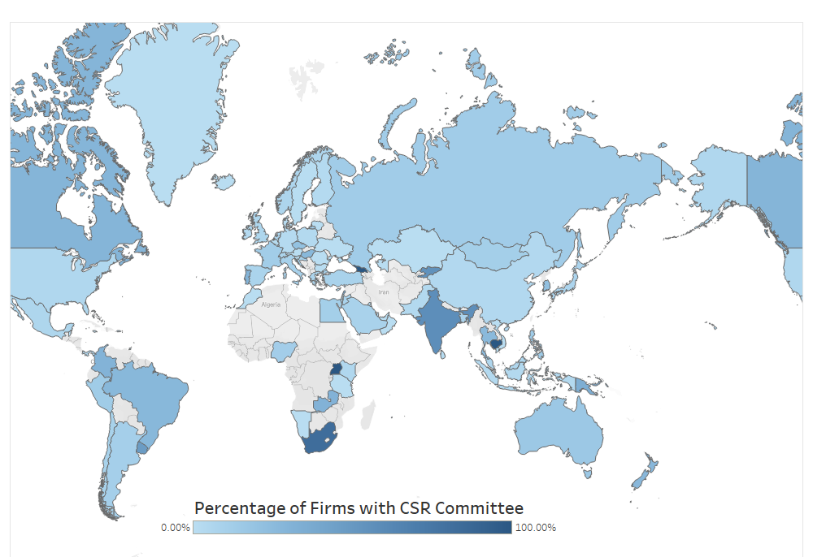
Prevalence of CSR Committees Around the World
United States 7%
South Africa 83%
United Kingdom 6%
India 68%
Canada 30%
Singapore 4%
* Mandatory in South Africa (2008) and India (2013)
Notes:
General pattern of CSR committees
Over time, prevalence increased
CSR committees are mostly popularly seen in xxx industries
Around the globe, the popularity of CSR co, mmittee varies…South Africa 80%, India 55%, US, Singapore
Countries with 100% CSR committees: Barbados (11), Cambodia (6), Georgia (3), Uganda (3)

Slide 11
Expectation: Types of firms voluntarily create CSR committees?
Resource Dependent Theory
CSR committee being instrumental for boards to provide resources – such as advice, legitimacy, reputation, communication, access to external networks – in sustainability
Potential reasons: external pressures from regulators, socially conscious shareholders and stakeholders
Institutional Theory
Firms mimic practices of successful peers
Potential reasons: industry peer pressure
Agency Theory
Knowledge specialization, individual accountability, mitigation of free-riding problems
Potential reasons: internal monitoring needs and low search cost
However, extra workload, search and hiring costs, information segregation problems
(Pfeffer and Salancik 2003; Hillman and Dalziel 2003)
(Meyer and Rowan 1977; DiMaggio and Powell 1983)
(Jensen and Meckling 1976; Fama and Jensen 1983)

Slide 12
Sample Data and Research Design
Data Types | Data Sources
Board/committee-level information | BoardEx
Firm financials | Compustat, WorldScope, FactSet
CSR performance and management practices | Refinitiv + Fiechter, Hitz, Lehmann (2022)
Country-level information | Yale EPI, Dyck, Lins, Roth, Wagner (2019), World Bank, Carrots & Sticks, PRI, manual collection
Final sample: 18,643 unique firms, 71 countries, 2002-2018
CSR committee_{i,t} = β₀ + β₁High socially conscious IO_{i,t-1} + β₂Low socially conscious IO_{i,t-1} + β₃CSR peers_{i,t-1} + β₄Environmental-material industry_{i} + β₅Social-material industry_{i} + β₆Post CSR disclosure regulation_{i,t-1} + β₇EPI_{i,t-1} + β₈Board size_{i,t-1} + β₉Board connectedness_{i,t-1} + β₁₀Board complexity_{i,t-1} + ∑ β_{k}Controls_{i,t-1} + ε_{i,t}
(1)
CSR Outcome_{i,t+n} = β₀ + β₁CSR committee_{i,t} + ∑ β_{k}Controls_{i,t} + ε_{i,t+n.} (2)

Slide 13
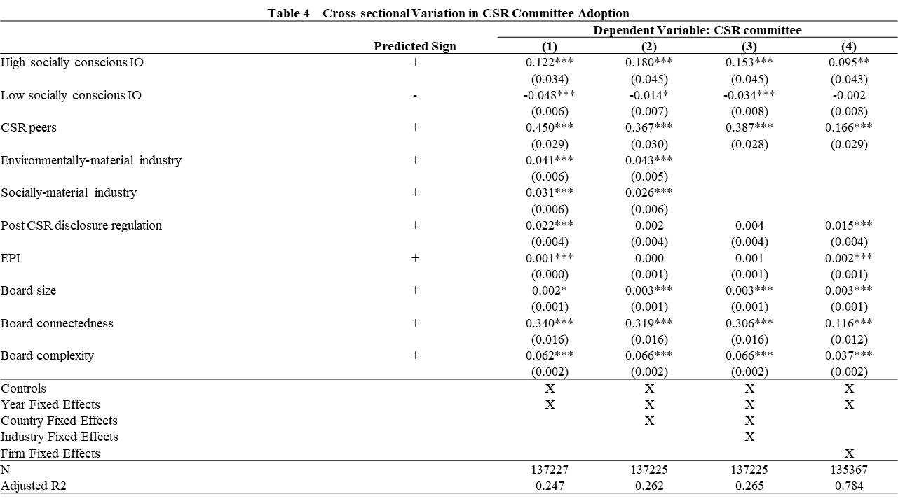
Results: Types of firms voluntarily create CSR committees?
.
Notes:
Controls: Firm size ROA Leverage Tobin's q Capital expenditure R&D expenditure Insider shareholding
All independent variables are lagged by one year

Slide 14
Expectation: Observable changes in CSR outcomes?
Decoupling?
Benefits outweigh costs → voluntary adoption
Marketing tool to attract customers and employees?
Boost ESG ratings to meet investors’ demand?
Conform to external pressure and maintain legitimacy？
Knowledge specialisation
Task-division efficiency
Individual accountability
Hiring costs
Extra workload
Information segregation
Expectation: Voluntary CSR committees are associated with changes in future CSR outcomes.
Notes:
One might argue that it is natural to predict that firms that do end up forming CSR committees are on average serious in its intent to implement internal CSR management practices and improve CSR outcomes
Firms may use CSR committees as a window-dressing device.
a marketing tool to attract consumers and employees who are particularly conscious of ESG related issues;
boost their ESG ratings and attract ratings-sensitive investors;
could be a part of a firm’s overall culture that emphasizes sustainability.
Overall, it is ex ante unclear whether having a separate board committee dedicated to CSR could have any real effects on a firm’s operations or on its CSR performance.

Slide 15
Results: Observable changes in CSR outcomes?

Slide 16
Results: Potential mechanisms?

Slide 17
Cross-sectional Variations
Q: Do the changes in CSR outcomes associated with CSR committees vary depending on external pressures?
A: Yes! But mainly for environmental outcomes.
External Pressures
Country-level environmental performance (Yale EPI)
- High
- Low
Industries with material environmental issues (e.g., oil & gas)
- High
- Low

Slide 18
Robustness Checks
Q1: Are the improved CSR outcomes explained by unobservable firm-specific factors?
A1: No. Results are robust to matched samples between voluntarily-adopted and never-adopted firms within the same industry and country.
Q2: Are results robust to alternative definitions of CSR committees?
A2: Yes.
Excluding observations after CSR committees are dissolved.
Closely defined CSR committees.
Q3: Are there mandatorily adopted CSR committees? How about their CSR outcomes?
A3: Yes.
India: Companies Act 2013 section 135, effective from April 2014.
South Africa: Companies Act 2008 section 72, effective from May 2011.
No evident improvement in CSR outcomes → plan to further compare voluntary versus mandatory CSR committees.

Slide 19
Conclusion and Discussion
Key findings:
Voluntary adoption of CSR committees is shaped by external demand, internal monitoring needs and search costs for forming a separate CSR committee.
Following the adoption, firms strengthen CSR management practices, experience subsequent improvements in environmental and social outcomes.
Such subsequent improvements in environmental and social outcomes are not observed for mandatorily adopted CSR committees.
→ Voluntary board CSR committees represent a substantive corporate governance mechanism for aligning business operations with long-term sustainability.
Contribution to literature & implication for practitioners/policymakers:
Internal governance and management of CSR issues
Benefits of CSR committees for CSR outcomes
Regulatory debate on mandating board-level CSR initiatives

Slide 20
Thank you! All comments welcome.
Contact Information:
Email: yuxia.zou@ntu.edu.sg

