Slide 1
Limited Accountability and Awareness in Corporate Emissions Targets Ended in 2020
Xiaoyan Jiang, Shawn Kim and Shirley Lu
2024 Annual GRASFI Conference

Slide 2
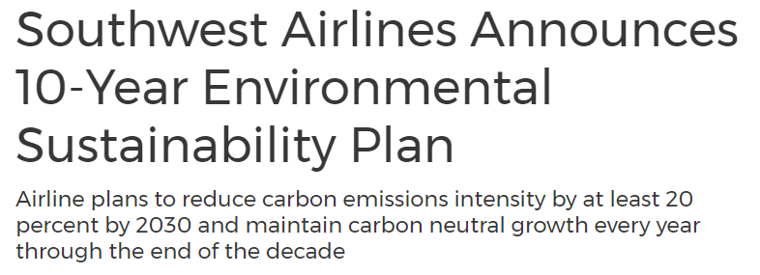
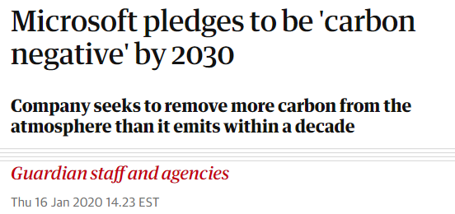
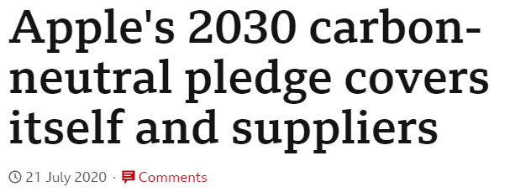
Notes:
Given that companies are responsible for the vast majority of global emissions, their role is critical in achieving the goal of limiting global warming by 1.5 degree Celsius.
Since the Paris Agreement of 2015 and 2018 special report by UN intergovernmental panel on climate change, companies are increasing announcing emissions reduction targets such as the net-zero pledges.
As you can see from the slide, the announcements of these emissions reduction targets often make media headline. And these targets are now considered as one of the most important corporate disclosure of current and future environmental performance, and is now a center of attention for investors, regulators, and other stakeholders.
However, what is often missing in the discussion about corporate emissions reduction targets is the discussion about the target outcomes and accountability around those targets. And to be fair, a big reason behind such gap is that a lot of these targets are long-term oriented with due years in 2030 or 2050 – leaving us with more than a decade until the final outcome of these targets are realized.

Slide 3
Research Question
Broad Question: Is there accountability over corporate emissions reduction targets?
Specific questions:
What happened to the targets that ended in 2020?
How transparent are the target outcomes?
What are the consequences of failing these targets?
Notes:
So, in this paper, we study the outcomes and accountability around corporate emissions reduction targets, by focusing only on the targets that expired in 2020.
Using that sample, we ask the following three questions.
First, what happened to the targets that ended in 2020? How many of them are achieved and failed?
Second, how transparent are the target outcomes? Is the information about target outcomes transparently disclosed and easily available to obtain?
Third, what are the consequences of failing these targets? Did companies that miss their targets suffer any negative consequence?
We believe that studying the consequences and accountability of 2020 targets are important as they provide insight about emissions targets that will expire in 2030, 2040, and 2050.
If we do not like what we are seeing with 2020 targets, now would be a great time to think about how to improve accountability and ultimately credibility of corporate emissions reduction targets.
We also believe that our study is directly related to the issue of greenwashing. Making empty environmental commitments has been identified as one of the methods of corporate greenwashing.
When companies set emissions reduction targets, you can think about these companies weighing this scale - in which there is the immediate benefits of announcing emissions target, such as the improved public perception of the company on one side, and the potential cost of penalty from missing these targets. A company would only announce emissions targets if the benefit exceeds the cost.
However, is there is no accountability around emissions reduction targets, I believe that this scale may be broken. Without any proper monitoring and accountability, there will be no real cost of missing these targets, and with no real cost, any company that excepts even the slightest benefits from announcing emission targets will announce one – and we’ll end up seeing a lot of empty promises.

Slide 4
Literature: Earnings Targets
Targets with strong accountability and high credibility
Consequences:
Negative market reaction (Skinner and Sloan, 2002)
Negative media coverage (Oliver et al., 2023)
Manager turnover (Mergenthaler et al., 2012)
Earnings discontinuity at zero (Burgstahler and Dichev, 1997)
Pre-announced earnings dates with earnings conference calls (Boulland and Dessaint, 2017)
Notes:
Conceptually, we’d like to compare companies’ emission reduction targets with another important targets that companies voluntarily announce – their earnings targets.
For earnings targets, it is very well established that there is strong accountability around them. Prior studies showed that missing earnings targets are associated with strong negative market reaction, negative media coverage, and higher likelihood of management turnover. Therefore, it seems like companies really want to avoid missing these targets, and we observe higher frequency of earnings just above zero and just above wall street consensus. Such strong accountability reduces our concern about companies window-dressing, trying to appear financially strong by announcing overly ambitious earnings targets – which is exactly what we’d like for emissions reduction targets as well.

Slide 5
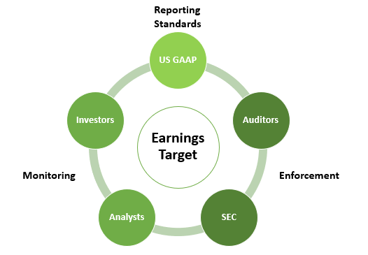
The role of institutions
Notes:
Now looking at earnings targets and emissions targets side by side, we see that there are sets of institutions around earnings targets that help with the monitoring and accountability of these targets. There is US GAAP and other reporting standards that standardized financial disclosure, auditors verifying the information, and SEC enforcing misreporting. We also have media and analysts covering earnings announcements, and investors responding to these information. Earnings announcement dates are pre-announced and accompanied with earnings conference calls making it easier for media and investors to follow the information.
Now, if we think about emissions reduction targets, we are not sure whether we have such institutions. Reporting standards for environmental information is still in development, external verification of these information is weak, and it is unclear who is monitoring and covering companies carbon performance and their progress toward their targets.

Slide 6
Sample and Data
Example 1 – Siemens
Absolute target
Scope 1+2
By 2020, reduce emissions by half relative to 2014 base year
Data: CDP 2010-2021
Meaningful 2020 Targets:
(1) Covers scopes 1 or 2
(2) Target coverage over 80%
(3) Horizon more than 3 years
1,041 firms
Scope 1 emissions: 2.5 billion tons in 2020 (~5% of global emissions)
Average: 3 percent reduction per year
Example 2 – Kraft Heinz
Intensity target
Scope 1+2
By 2020, reduce emissions per ton of products produced by 15% relative to 2015 base year
Notes:
To study the outcomes and accountability of emissions reduction targets, we focus exclusively on targets that expired in 2020.
An example of such target is Siemens that promised to reduce their Scope 1 and 2 emissions by 50% in 2020 relative to their 2014 emissions.
We add additional requirements for targets to make sure we are capturing significant, organizational-level long-term emissions targets. We target should not be just about scope 3, the target coverage should be greater than 80%, and the target horizon has to be more than 3 years.
That leads us to a sample of 1041 firms with such 2020 emission targets, and these companies’ scope 1 emissions cover around 5% of the global emissions.

Slide 7
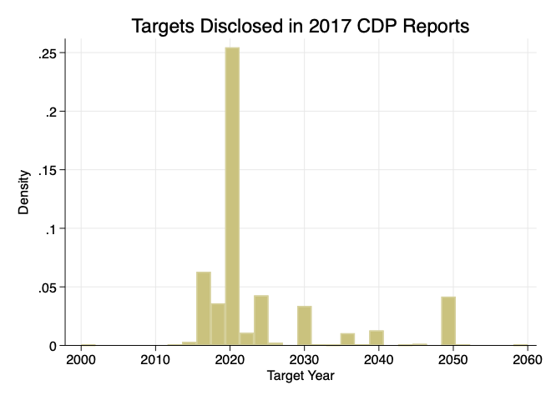
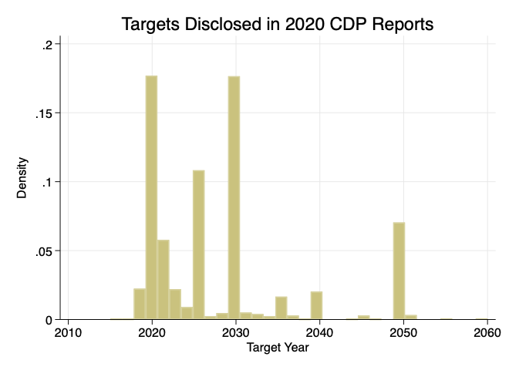
Sample and Data
Data: CDP 2010-2021
Meaningful 2020 Targets:
(1) Covers scopes 1 or 2
(2) Target coverage over 80%
(3) Horizon more than 3 years
1,041 firms
Scope 1 emissions: 2.5 billion tons in 2020 (~5% of global emissions)
Average: 3 percent reduction per year
Notes:
You might ask “Why 2020 targets?” Isn’t 2050 targets the most important, ultimate emissions targets that we should care about?
While I agree that 2050 targets are the most important, we argue that we simply cannot wait until 2050 to study the outcomes and accountability around those targets. That would be just too late.
Descriptively, we see that companies often set emissions reduction targets with due years at the end of each decade – targets ending in 2020, 2030, 2040, and 2050. And from the plot which shows the target years of all targets disclosed in CDP in 2017, we see that pattern of companies setting targets at the end of each decade, and also a lot of 2020 targets. In 2019, which is the plot below, we see a lot of 2020, 2030, and 2050 targets.
So, 2020 is the first year in which we get to observe the final outcomes of companies long-term emissions reduction targets in a large sample. Therefore we believe that is a great setting to study the consequences and accountability of emission reduction targets.

Slide 8
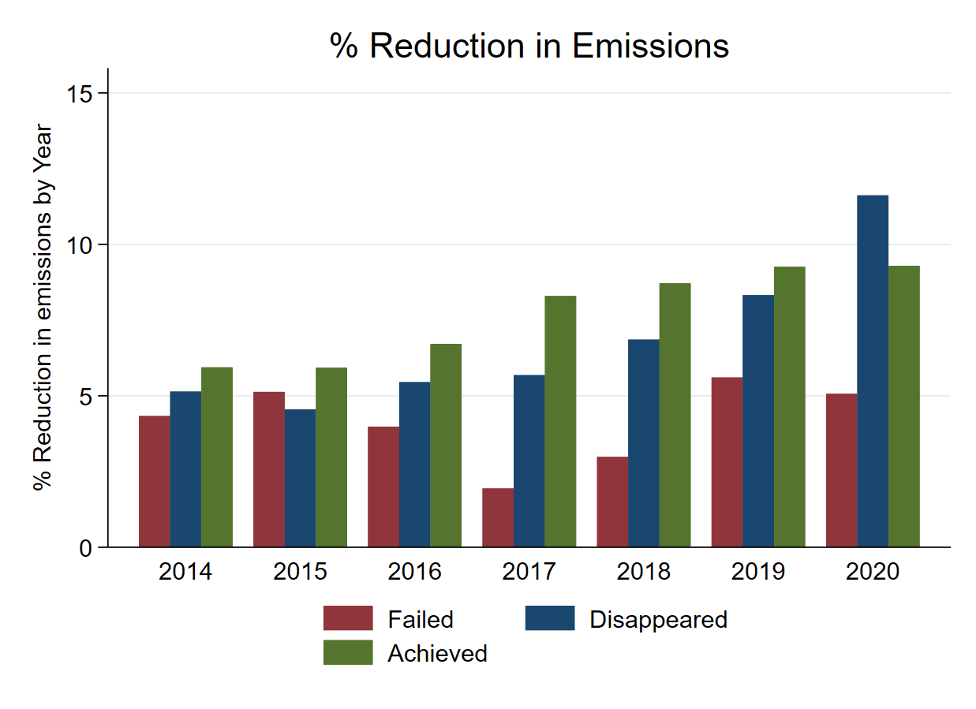
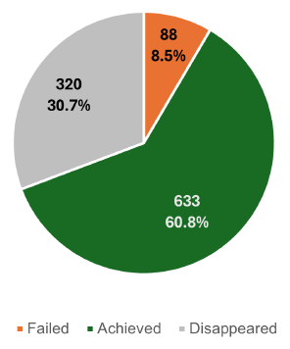
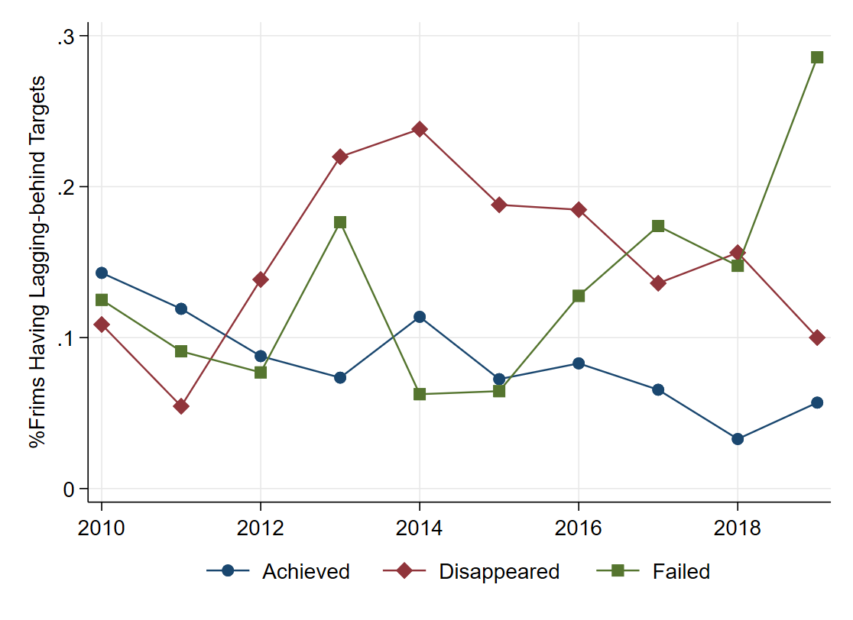
RQ1: Target outcomes
Notes:
To answer our first research question, we first show what happened to those 2020 emissions reduction targets. Of the 1041 targets, 61% of them were achieved and 9% of them failed. Interesting 31% of these targets disappeared. And by disappeared, we mean that these companies disclosed their 2020 targets in earlier annual disclosure, and at some point, stopped disclosing their progress toward these targets, and did not disclose the outcome of these targets in 2020 disclosure. So for these disappeared companies, unless you compare 2020 emissions with the targeted emissions from earlier annual disclosure yourself, you will not able to tell the target outcomes.
These disappeared companies are an interesting bunch. Through deeper investigation to some of these cases, it seemed to us that disappeared companies are a mix of two of types of companies – those that silently drop targets perhaps because they accessed higher likelihood of failure, and those the removed 2020 targets for more ambitious future targets. The annual percentage reduction in emissions seems consistent with achieved companies with the highest emissions reductions, followed by the disappeared group, and then the failed companies.
Acknowledging that disappeared companies may be a sum of two groups of firms, in our future analyses, we divide disappeared companies into two groups (leaders and laggards) based on the industry-adjusted emissions reductions.
(at 5 min)
Provide 2 examples of disappeared:
bad: Finnair reported a target of a 17% improvement in emissions intensity from base year 2013 to 2020 in both
CDP and their own sustainability reports for fiscal 2019, but they were already behind the target
progress in fiscal 2019 by only completing 54% reduction. The target outcome was not reported in
2020, and they also acknowledged in their 2019 sustainability report that “the ambitious target is
estimated to be unreachable during the coming year.”
2. Good: Hyundai Motor. In their 2018 CDP reports, they stated that the company has adjusted its emissions target to align with both the government’s GHG reduction targets and the goals outlined in the Paris Agreement, and the target year has been subsequently updated to 2030 and 2050

Slide 9
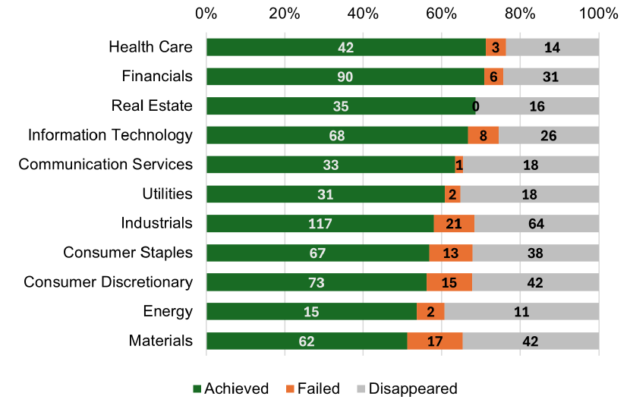
RQ1: Target outcomes
Notes:
We provide some descriptive on how the target outcomes vary across industries. Industries with the highest target achievement proportions are health care and financials. Industries with the lowest target achievements are materials and energy. The fact that a lot of carbon-industries are in the lowest side of the plot may be concerning to us, because it is the targets from these companies that may be the most important.

Slide 10
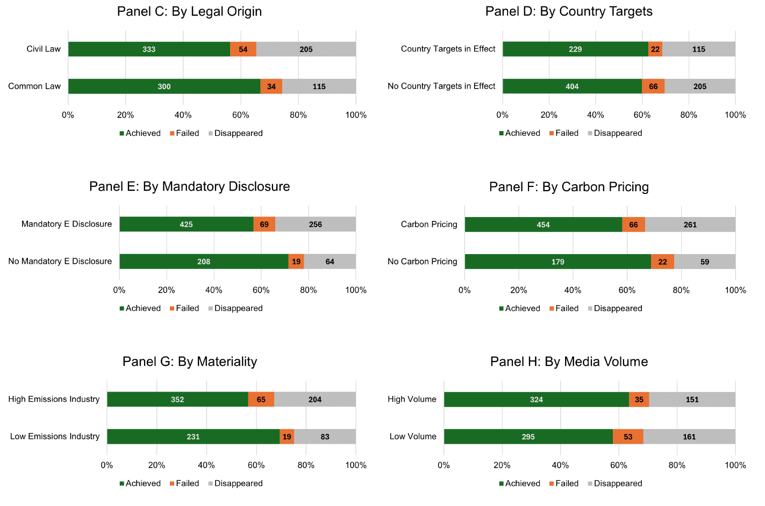
RQ1: Target outcomes
Notes:
Next, we show how the likelihoof of target achievement varies based on various country-level and other firm characteristics.
Companies in common law countries more likely to achieve targets
Country-level emissions targets have no association with target outcomes.
Country-level mandatory disclosure and carbon pricing associated with more failed and disappeared targets.
Companies in low-carbon industries and higher media coverage more likely to achieve targets and less likely to have disappeared targets.
Overall, we do not see one strong institution or monitoring mechanism that is super effective on improving target outcomes. This may suggest that we need a set of institutions working together like the earnings targets setting to improve the accountability and credibility of emissions targets.

Slide 11
RQ2: Transparency
Outcome:
3% (3/88) failed firms covered by the media
51 media articles (48 achieved + 3 failed)
Set Target:
89 media articles of setting 2020 targets
Notes:
Next, we examine how the information about the target outcomes is disclosed and disseminated.
So, for the 88 companies with failed 2020 emission reduction targets, we manually go through their ESG reports to see if they disclosed their target failures.
We found that only 33.3% of the companies acknowledged their 2020 target failure in their ESG reports, and only 20% of them explicitly acknowledged their target failure through language such as “failed” or “missed.”
So after seeing that companies themselves are not so transparent about their target failure, we move on to the role of media. Even if companies are not so transparent, media could play a role in identifying and disseminating information about emissions target outcomes. Again, through a manual search, we identified 51 media articles related to 2020 target outcomes, of which 48 of them are related to target achievements and only three about failed targets. And even more disappointingly, we find that all the three companies with media coverage of failed targets were those that acknowledged their failure in their ESG reports. This suggests that while media seems to be disseminating target failure to some degree, it’s role in identifying failed companies and improving the transparency of target outcomes seems limited.
And when we compare media coverage of the announcements of 2020 targets, we find that the media is much more likely to cover target announcements than target outcomes. Overall, the role of media in improving the transparency and accountability of emissions reduction targets seems questionable, given that they seems to cover what companies would like them to cover – the announcements of targets and target achievement.

Slide 12
RQ3: Consequences
Market reaction to target outcomes (Bolton and Kacperczyk, 2021; Pástor et al., 2022)
ESG ratings (Berg et al., 2022, Huang and Lu, 2022)
Media sentiment (Dyck and Zingales, 2002; Baloria and Heese, 2018)
Shareholder proposals (Flammer et al., 2021)
Notes:
Finally, and perhaps most importantly, we investigate the consequences of failed emissions reduction targets. This analysis could show whether companies suffer any penalties for missing emissions reduction targets – which is central to the discussion of accountability and credibility of emissions reduction targets.
For potential penalties, we focus on entities that may be the target audience of emission reduction targets. We look at market reaction, response from ESG rating agencies, media sentiment, and shareholder proposals.

Slide 13
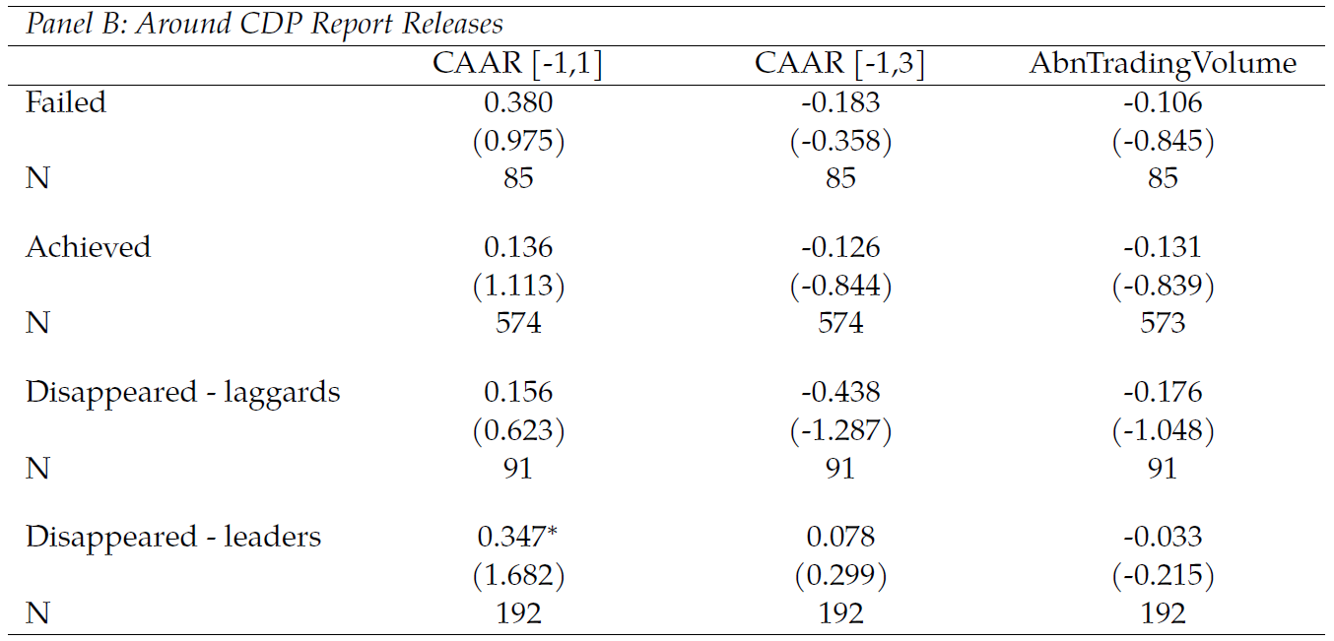
Market reaction
Notes:
First, the market. We identify information events related to the release of target outcomes. We use 2020 CDP report release, 2020 sustainability report release, and media coverage events of 2020 target outcomes as three information events related to target outcomes and study the market responses around those events.
For all three information events, we do not observe any significant return or volume responses. This slide shows the market response around 2020 CDP report release, and we do nto see any significant difference among companies with failed, achieved, or disappeared companies.

Slide 14
Market reaction
Notes:
Note: consistent with Sloan paper on sustainability report dates

Slide 15
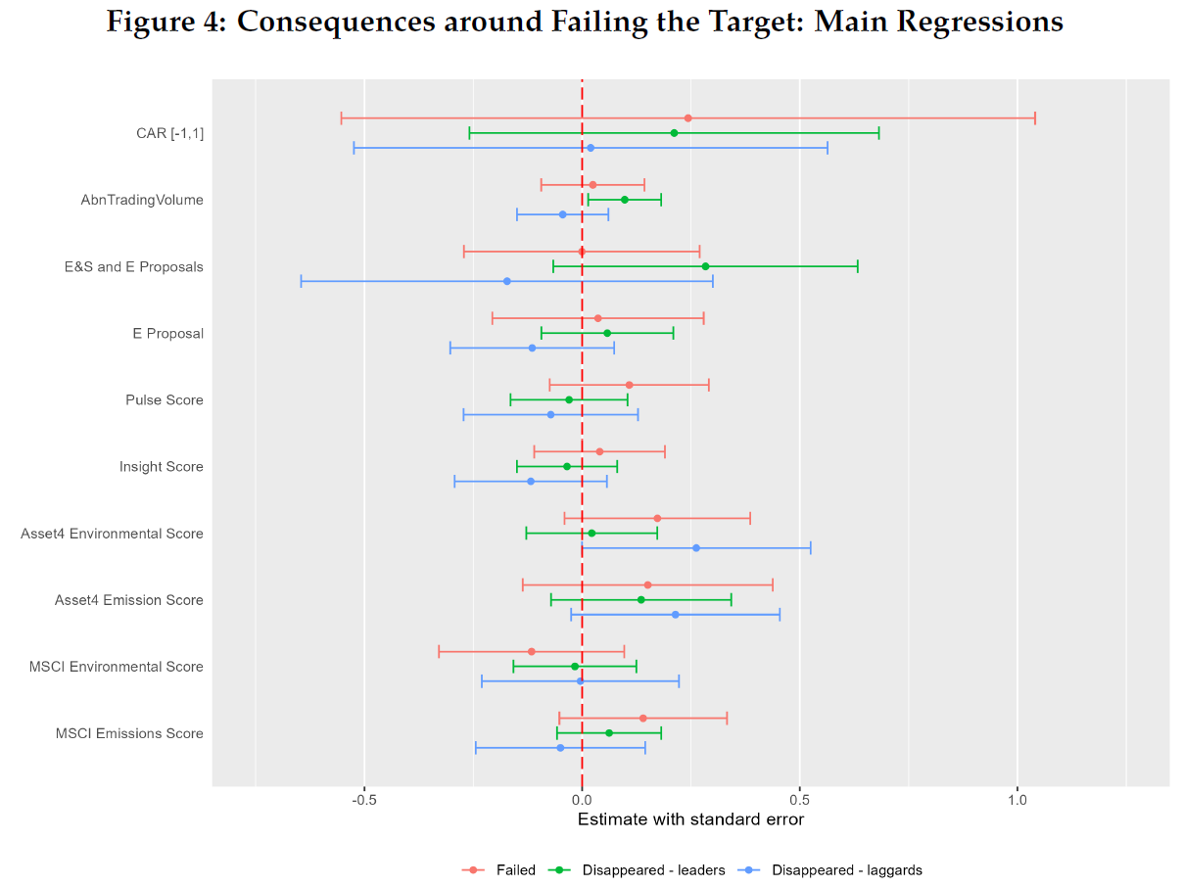
Consequences
No significant negative consequences (market reaction, environmental shareholder proposals, media sentiment, ESG ratings) for missing emissions targets
Notes:
After observing the market response, we also test whether companies that failed emissions targets see more environmental shareholder proposals, negative media sentiments, or lower ESG ratings, compared to companies that achieved 2020 targets.
For all of those potential outcomes, we do not find evidence to suggest that companies suffer any penalties for missing emissions reduction targets.
While we point to the lack of institutions around emissions targets to provide proper transparency and oversight as the main cause for the lack of consequences, we awknowledge that there could be other drivers for the lack of consequences.
No oversight– information cost (need media dissemination; don’t know when is information coming out/ lack of standard, ESG ratings, stakeholders not seeking this information)
No one penalizes (despite knowing about it) (acknowledge)
Maybe setting target is enough as signal of doing things – so not about outcome
Learning – both firm and stakeholders

Slide 16
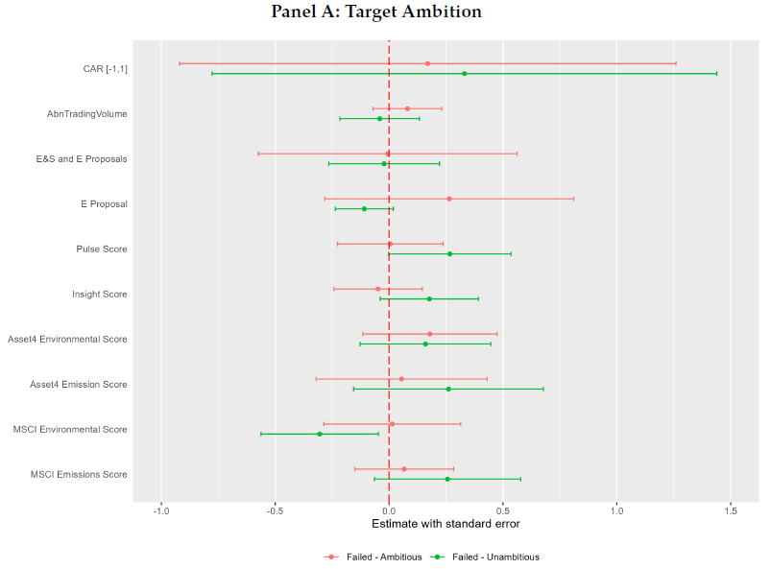
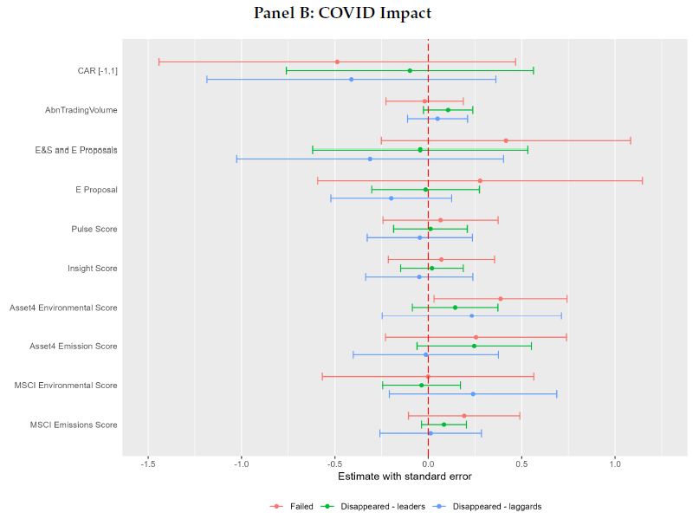
Alternative Explanations
Target difficulty & Impact of COVID
Notes:
A potential explanation for the lack of consequences is that failed targets are more difficult or ambitious. In this case, stakeholders may be okay with the fact that these ambitious targets are missed, because companies are still making satisfactory progress. To address this, we divided failed targets into more amibitous and less ambitious ones based on the targeted emissions reduction percentages - and still find insignificant consequences for both types of failed companies.
Only keeping industries less affected by COVID.

Slide 17
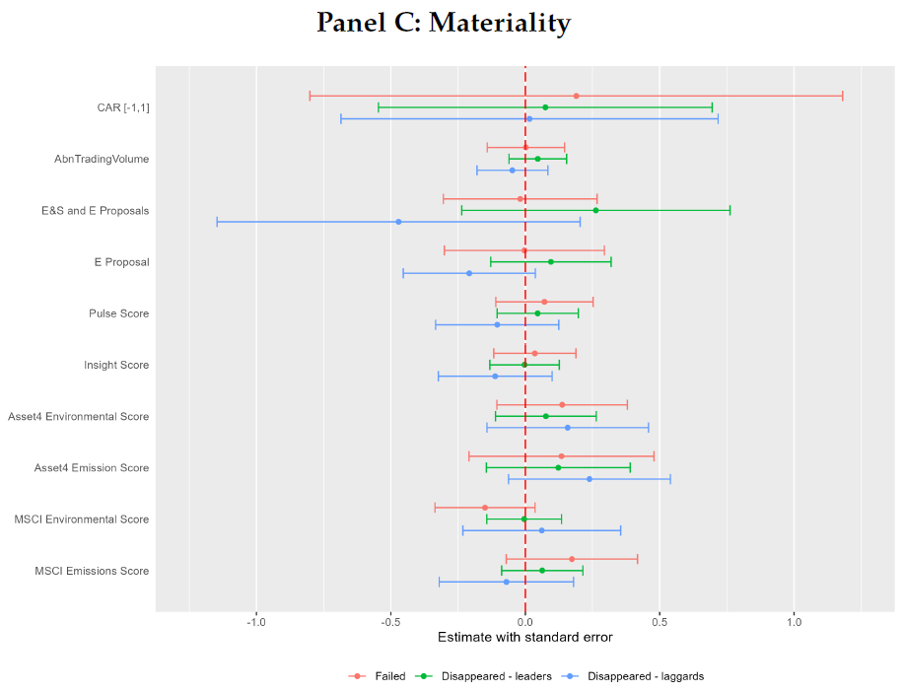
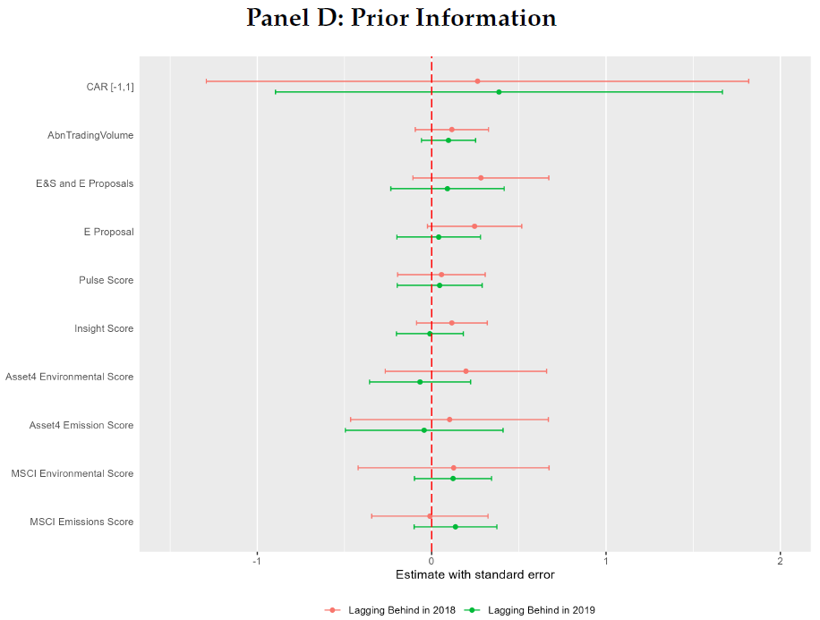
Alternative Explanations
Carbon materiality & Already “priced” based on prior information
Notes:
Only keeping carbon-intensive industries.
Another potential explanation is that the market and other stakeholders already responded to the information about companies target progress. That is, stakholders may already knew in 2018 that these companies are going to fail in their 2020 targets, and have already priced that in. To address this possibility, we construct a measure for the likelihood of target failure in 2018 and 2019, and tested if the stakeholders responded to that information in 2018 and 2019. Again, we do not see any significant response to target progress information in 2018 and 2019, inconsistent with the explanation that stakeholders already responded to target outcomes before 2020.

Slide 18
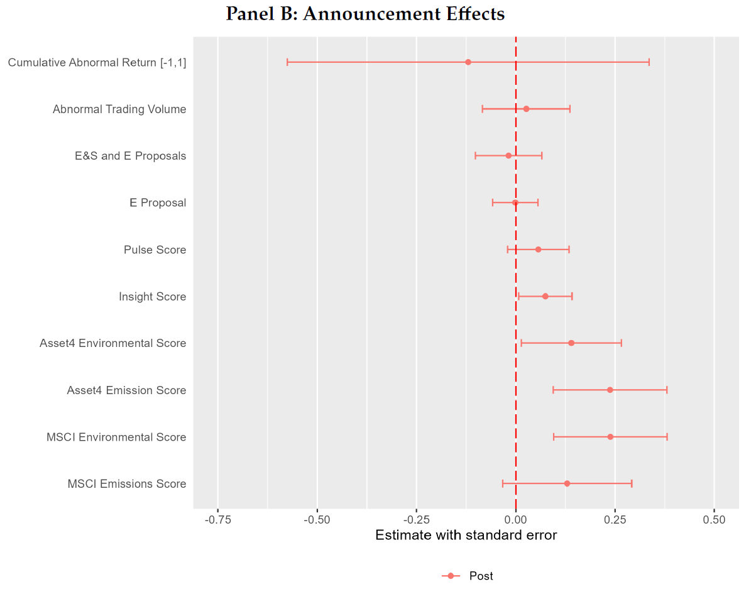
Contrasting to initial announcements of 2020 targets
Companies seem to enjoy higher ESG ratings and positive media sentiment by announcing emissions reduction targets
Potential for a “free lunch”?
Notes:
After observing the lack of penalties for failed targets, we contrast this with the potential benefits that companies enjoy for announcing these targets.
We examine the same outcomes around the announcement

Slide 19
Role of Media coverage?
Environmental Shareholder Proposal
Environmental Shareholder Proposal

Slide 20
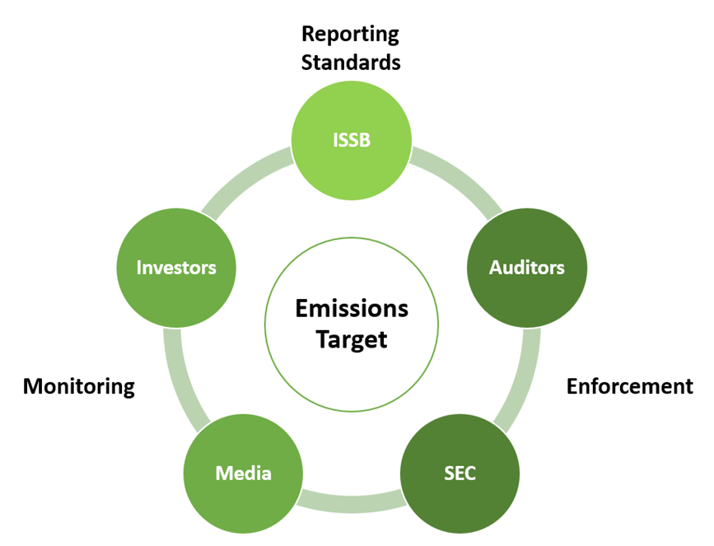
Conclusion
Weak accountability over emission reduction targets
Low transparency and lack of dissemination on target outcomes
Lack of consequences for failing emissions targets
Contrast with benefits of announcing targets
Insights for 2030, 2040, 2050
Role of supporting institutions and information dissemination
Pre-announcing information release date as in earnings targets?
Notes:
Overall, we find limited accountability on emissions reduction targets that expired in 2020.
Target outcome is not disclosed transparently, and companies that failed or silently removed their targets did not suffer any negative consequences. This is in direct contrast with improved ESG ratings and media sentiment following the announcements of 2020 targets.
Our findings provide insight for emissions targets that will expired in the future. Drawing parallel to the earnings targets, we suggest the role of institutions supporting the accountability of emissions tragets. Simple things like pre-announcing information release date as in earnings announcements could help.
Thank you and I look forward to your comments!

Slide 21
Appendix

Slide 23
RQ1: Target outcomes

Slide 24
Disappeared Targets
Updated targets: E.g., Hyundai Motor
In their 2018 CDP reports, they stated that the company has adjusted its emissions target to align with both the government’s GHG reduction targets and the goals outlined in the Paris Agreement, and the target year has been subsequently updated to 2030 and 2050.
Lagging behind: E.g., Finnair
Finnair reported a target of a 17% improvement in emissions intensity from base year 2013 to 2020 in both CDP and their own sustainability reports for fiscal 2019, but they were already behind the target progress in fiscal 2019 by only completing 54% reduction. The target outcome was not reported in 2020, and they also acknowledged in their 2019 sustainability report that “the ambitious target is estimated to be unreachable during the coming year.”

