Slide 1
ESG Reporting Divergence
Qiang Cheng
Yun Lou
Mengjie Yang
September 2024
GRASFI Annual Conference

Slide 2
Motivation
Corporate accountability requires ESG information.
ESG reporting is voluntary in the U.S.
    70% of Russel 1000 firms reported on ESG activities in 2020
    Some follow frameworks, but others do not
    The frameworks followed by companies vary: GRI (59%), SASB (45%), TCFD (23%)
  → Information is not comparable across firms, which has impeded ESG investing (the 2017 CFO Institute survey).

Slide 3
Examples of Difference in ESG reporting

Slide 4
Research Objective
To investigate the adverse consequences of ESG reporting divergence for users
  ESG rating providers
    Does ESG reporting divergence affect ESG rating disagreement?
  ESG mutual fund
    Does ESG reporting divergence affect ESG fund allocation with respect to firms’ ESG performance?

Slide 5
Predictions
ESG rating providers:
  Costs of information processing (of focal and comparable firms’ ESG) ↑
  For ESG rating providers
    The reliance on public ESG information ↓
    The reliance on private information ↑
H1: Ceteris paribus, ESG reporting divergence is positively associated with ESG rating disagreement.

Slide 6
Predictions
  ESG mutual funds
  They rely on ESG ratings and ESG information to make asset allocation decisions (Avramov et al. 2022).
  Firms with better ESG performance attract ESG fund (Hartzmark and Sussman 2019).
ESG reporting divergence →Costs of information processing ↑
    ESG funds find it more difficult to evaluate firms’ ESG performance.
    ESG funds rely less on ESG performance to allocate assets.
H2: Ceteris paribus, the association between ESG ratings and ESG fund allocation is weaker for firms with high ESG reporting divergence than for firms with low ESG reporting divergence.

Slide 7
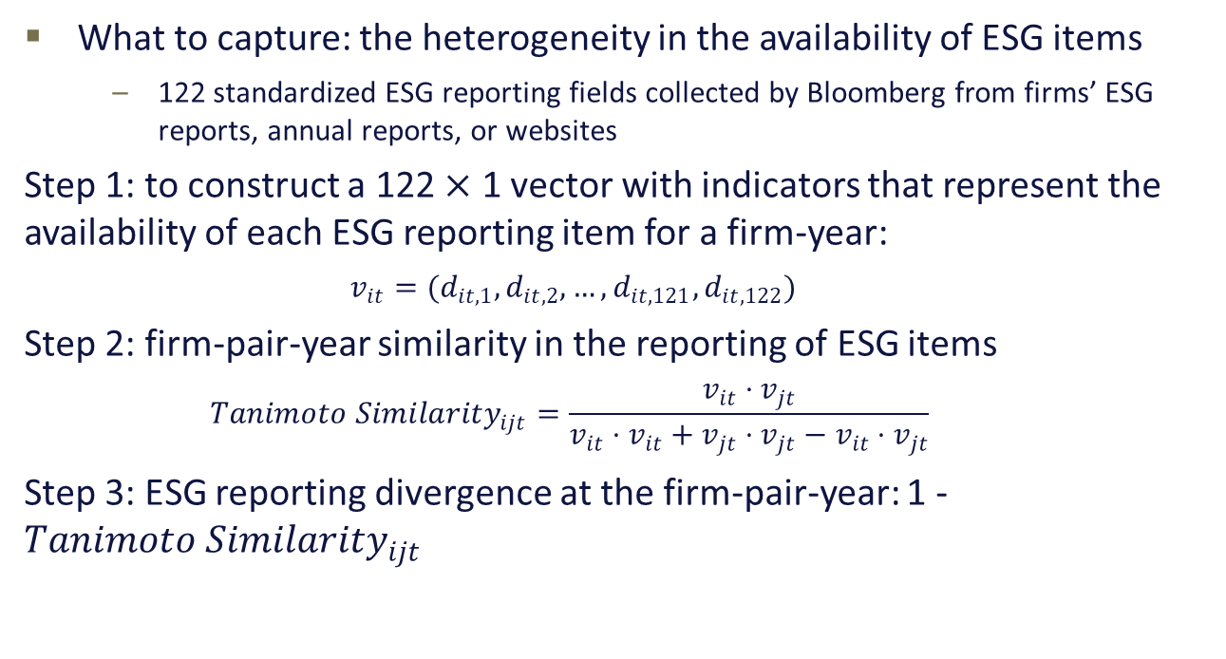
Construction of ESG reporting divergence
What to capture: the heterogeneity in the availability of ESG items
    122 standardized ESG reporting fields collected by Bloomberg from firms’ ESG reports, annual reports, or websites
  Step 1: to construct a 122 $×$ 1 vector with indicators that represent the availability of each ESG reporting item for a firm-year:
    $$v_{it}=(d_{it,1},d_{it,2},…, d_{it,121},d_{it,122})$$
Step 2: firm-pair-year similarity in the reporting of ESG items
    $$Tanimoto{ Similarity}_{ijt}=\frac{v_{it}⋅v_{jt}}{v_{it}⋅v_{it}+v_{jt}⋅v_{jt}−{v_{it}⋅v}_{jt}}$$
Step 3: ESG reporting divergence at the firm-pair-year: 1 - $Tanimoto{ Similarity}_{ijt}$

Slide 8
Example: Advanced Micro (i) and Intel (j) in 2020
ESG_Diverg = 1 - Tanimoto Similarity = 1 - $\frac{70}{75+90−70}$ = 0.263
E_Diverg = 1- Tanimoto Similarity =1 - $\frac{22}{25+30−22}$ =0.333
S_Diverg = 1- Tanimoto Similarity = 1 - $\frac{19}{21+30−19}$ = 0.406
G_Diverg = 1 - Tanimoto Similarity =1 - $\frac{29}{29+30−29}$ =0.033

Slide 9
Validation Tests

Slide 10
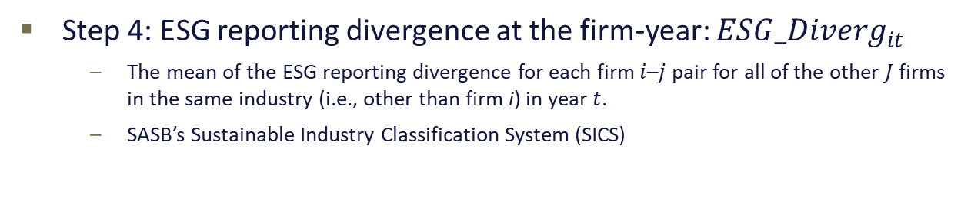
Construction of ESG Reporting Divergence (cont’d)
Step 4: ESG reporting divergence at the firm-year: ${ESG_Diverg}_{it}$
    The mean of the ESG reporting divergence for each firm $i$–$j$ pair for all of the other $J$firms in the same industry (i.e., other than firm i) in year $t$.
    SASB’s Sustainable Industry Classification System (SICS)

Slide 11
Main Tests of H1
A relative increase of 2.4% (6.4%, 2.5%, 2.7%) from sample mean for ESG (E, S, G) reporting divergence.

Slide 12
Main Tests of H2
  A relative decrease of 32.6% (24.5%, 51.2%, 7.6%) from sample mean for ESG (E, S, G) reporting divergence.

Slide 13
Sensitivity Tests
  Alternative measures of reporting divergence:
    TNIC industry classification
    SASB materiality items
  Use firm fixed effects
  No differential effects across high and low ESG disclosure subsamples

Slide 14
Additional Test: Spillover Effect of EU Regulation
  European Union (EU) passed Directive 2014/95
    public-interest entities in the EU with more than 500 employees to prepare annual nonfinancial reports (i.e., ESG reports) from fiscal year 2017.
    The objective: “to increase the relevance, consistency and comparability” of ESG reporting among the EU firms.
  This applies to US firms’ subsidiaries in the EU
  → Potential effect on US parent firms
  ↓ ESG reporting divergence among industries with a high proportion of firms with subsidiaries in the EU (treatment firms)
  ↓ ESG rating disagreement
  ↑ ESG fund allocation with respect to ESG performance

Slide 15
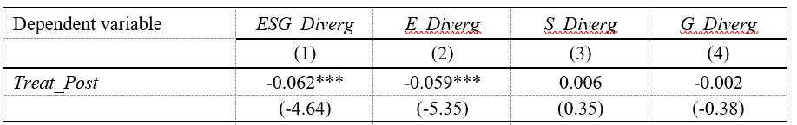
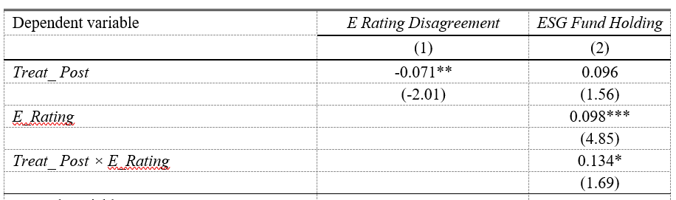
Additional Test: Spillover Effect of EU Regulation
Panel A:
Panel B:

Slide 16
Contributions
This is the first paper that provides systematic evidence on ESG reporting divergence among US firms.
This paper contributes to the literature
    ESG rating disagreement: ESG reporting divergence is an important determinant
    Comparability: this paper extends the literature from financial reporting comparability to non-financial information comparability
The paper provides suggestive evidence on the potential effect of the SEC proposals on climate risk and ISSB proposals on sustainability reporting.

