Slide 1
Pricing the Priceless:
The Financial Cost of Biodiversity Conservation
Fukang Chen ¹ Minhao Chen ¹ Lin William Cong ²
Haoyu Gao ¹ Jacopo Ponticelli ³
¹ Renmin University of China
² Cornell Johnson, IC3, & NBER
³ Northwestern Kellogg, NBER & CEPR
7th Annual GRASFI Conference
September, 2024
Notes:
注：如果想要修改页面底部作者条和文章题目条，请在“视图”—“幻灯片母版”界面操作
陈福康
chenfukang12345@163.com
2024.04.10

Slide 2
Motivation
Biodiversity matters
Over 50% of global GDP depends on nature (UN, 2022)
25% of species threatened with extinction (Díaz et al., Science, 2019)
“Biodiversity loss & ecosystem collapse”: 3rd worst long-term risk (WEF, 2024)
Global biodiversity financing gap
Additional investments needed ≈ $700 billion per year (Deutz et al., 2020)
Incentivizing private sector remains challenging (Flammer et al., 2023; Karolyi & Tobin-de la Puente, 2023)
Government takes the most conservation efforts
financial implications: lack of evidence

Slide 3
This Paper...
Research question: How investors price (govt-led) biodiversity transition
short-term transition costs vs. long-term sustainability
nation-wide investors vs. local biodiversity improvements
Setting: Green Shield Action (GSA) in China
enforces preservation rules in national nature reserves (NNRs)
covers all NNRs for the first time in 2017 & repeated annually
• 20K+ issues found, 6M+ m² constructions razed, 1K+ officials accountable...
local govts have little discretion in implementation (GSA & NNRs)
local govts are mainly responsible (including funding) for NNRs
Empirical strategy:
DID: municipalities with vs. without NNRs around the introduction of GSA
pre-existing NNRs, balance tests, pre-trend analyses...
outcome variables: municipal corporate bond (MCB) spread

Slide 4
Preview of Main Findings
GSA increased MCB spreads: by ~24 bps
additional interest payments: estimated ~$40 billion (2018-2021)
Potential mechanism
shutting down illegal economic activities within NNRs
expanding local public spending on NNRs
× not driven by (potentially) more public financing demand
× not driven by (potentially) higher local political risk
Heterogeneity: larger effects in
bonds with shorter maturities & local govts in weaker fiscal conditions
“Value” vs. “Values”
local biodiversity improved
pursuit of financial returns ＞ non-pecuniary preferences on biodiversity

Slide 5
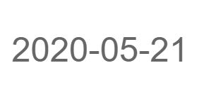
National Nature Reserves
NNR: plausibly exogenous treatment
typical natural habitats for rare and endangered wild species (nature reserves)
a cornerstone in protecting biodiversity and natural capital.
only reserves “holding general significance domestically and internationally, exerting remarkable international scientific influence, or possessing extra-ordinary research value” can be designated as NNRs
established by central govt department
National Nature Reserve Review Committee
the most extensive regulatory oversight & the strictest legal provisions
predetermined in GSA

Slide 6
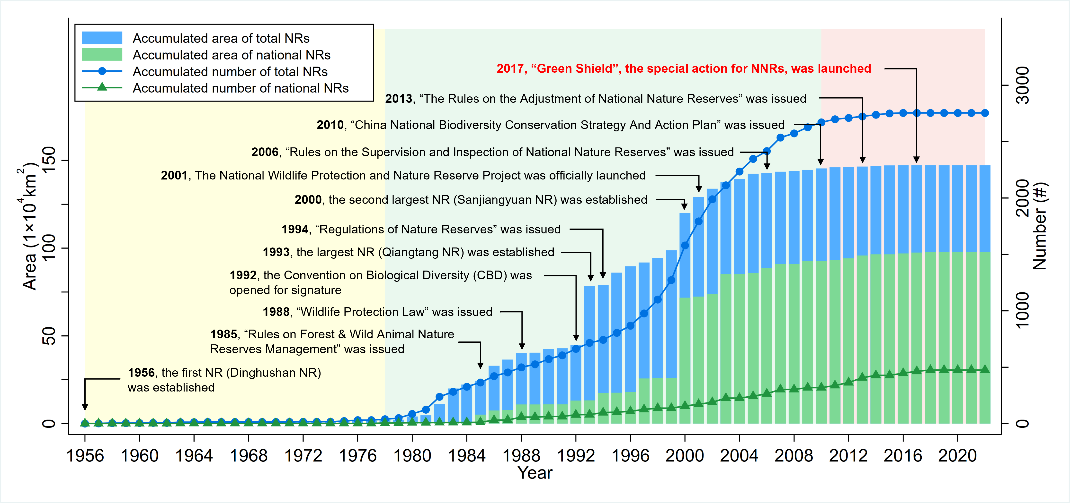
Treatment vs. Control Groups
The establishment of NNRs: predetermined

Slide 7
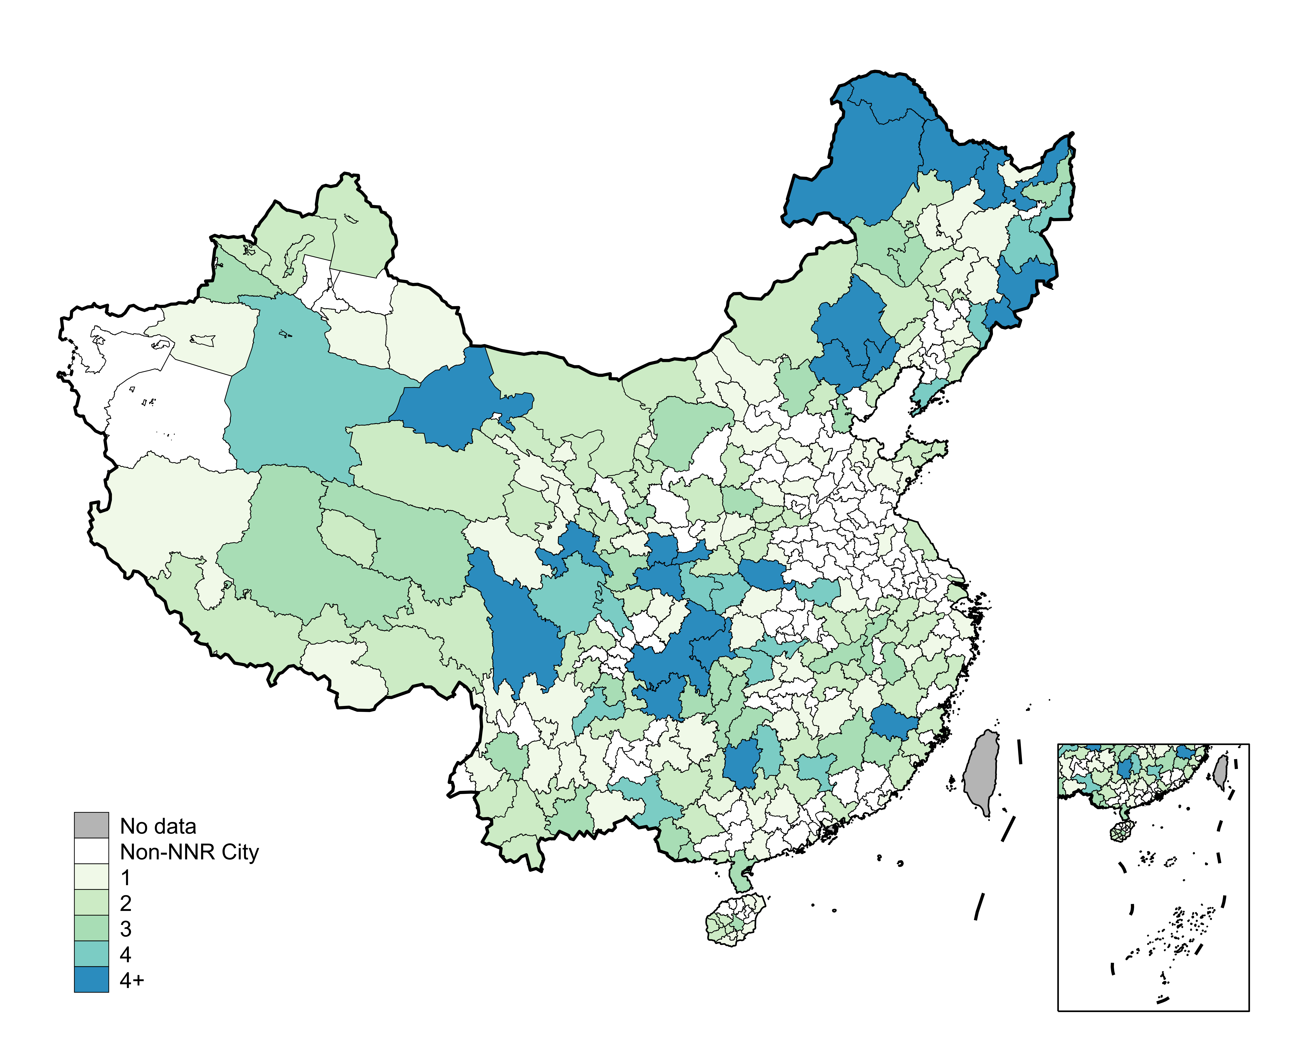
Treatment vs. Control Groups
The geographical distribution of NNRs

Slide 8
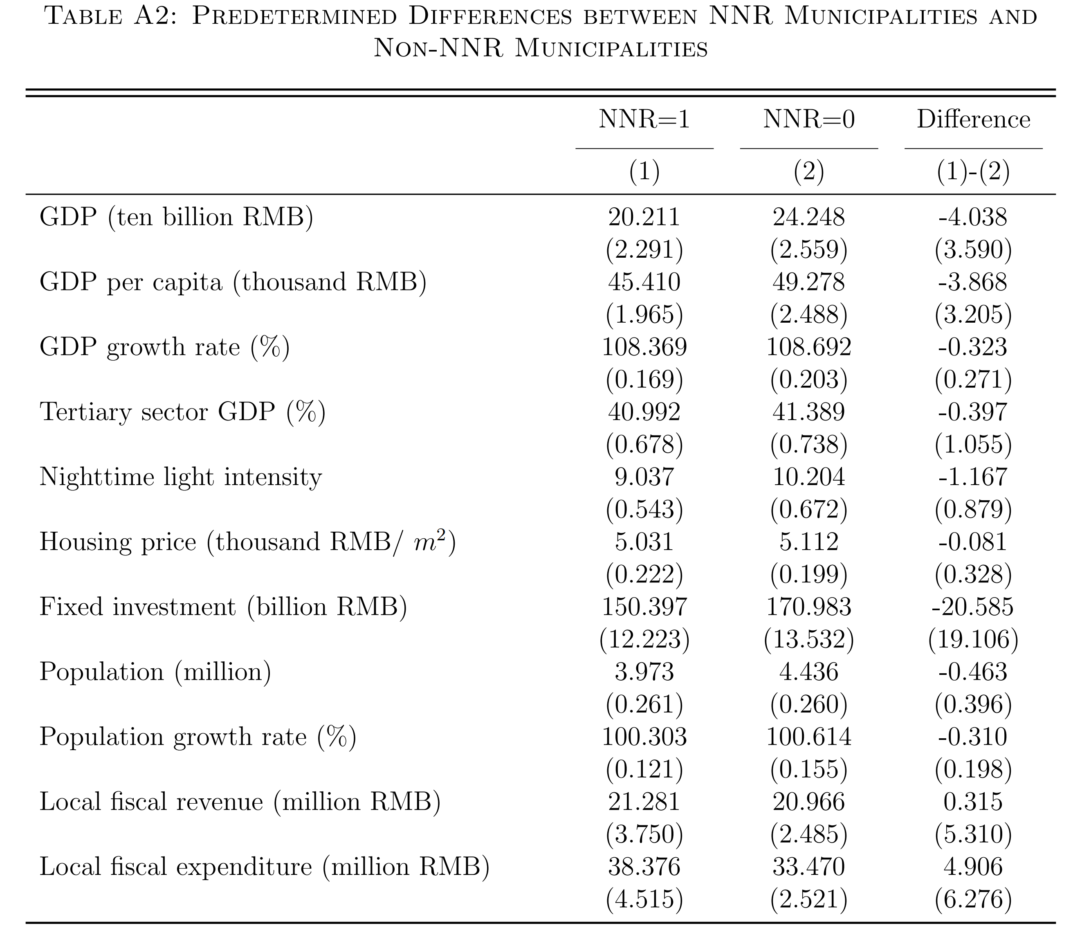
Treatment vs. Control Groups - Balance Test

Slide 9
Data
NNR
NNR lists: the Ministry of Ecology and Environment
a digital map of NNRs
borders, dates of inception…
merge it with other GIS data
city border map
satellite/remote sensing datasets: land cover, nighttime lights…
MCB
the only asset with market prices reflecting financing costs of Chinese local govt debt
yield spreads: following Geng & Pan (2024 JF)
quarterly level panel, CDB yield reference ...

Slide 10
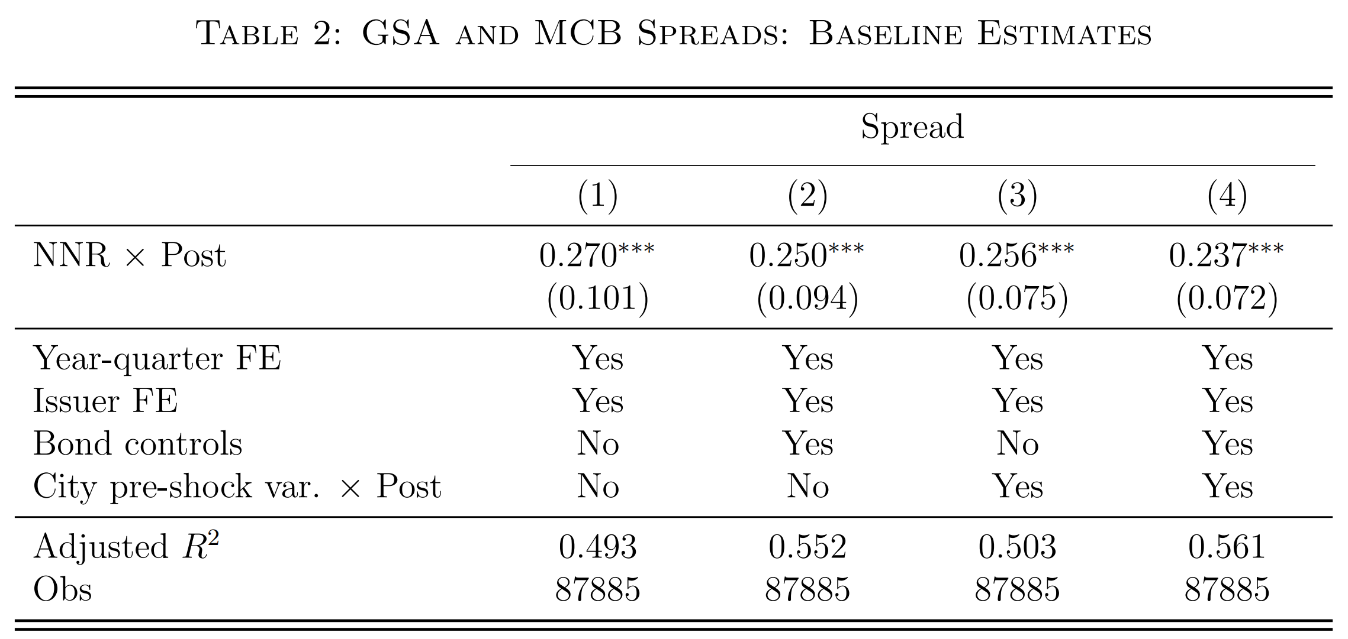
Baseline Results
$Spread_{bict}=δ_{ic}+λ_{t}+ βNNR_{c}×Post_{t}+θX_{c}×Post_{t}+ γZ_{bict} + ε_{bict}$ (1)

Slide 11
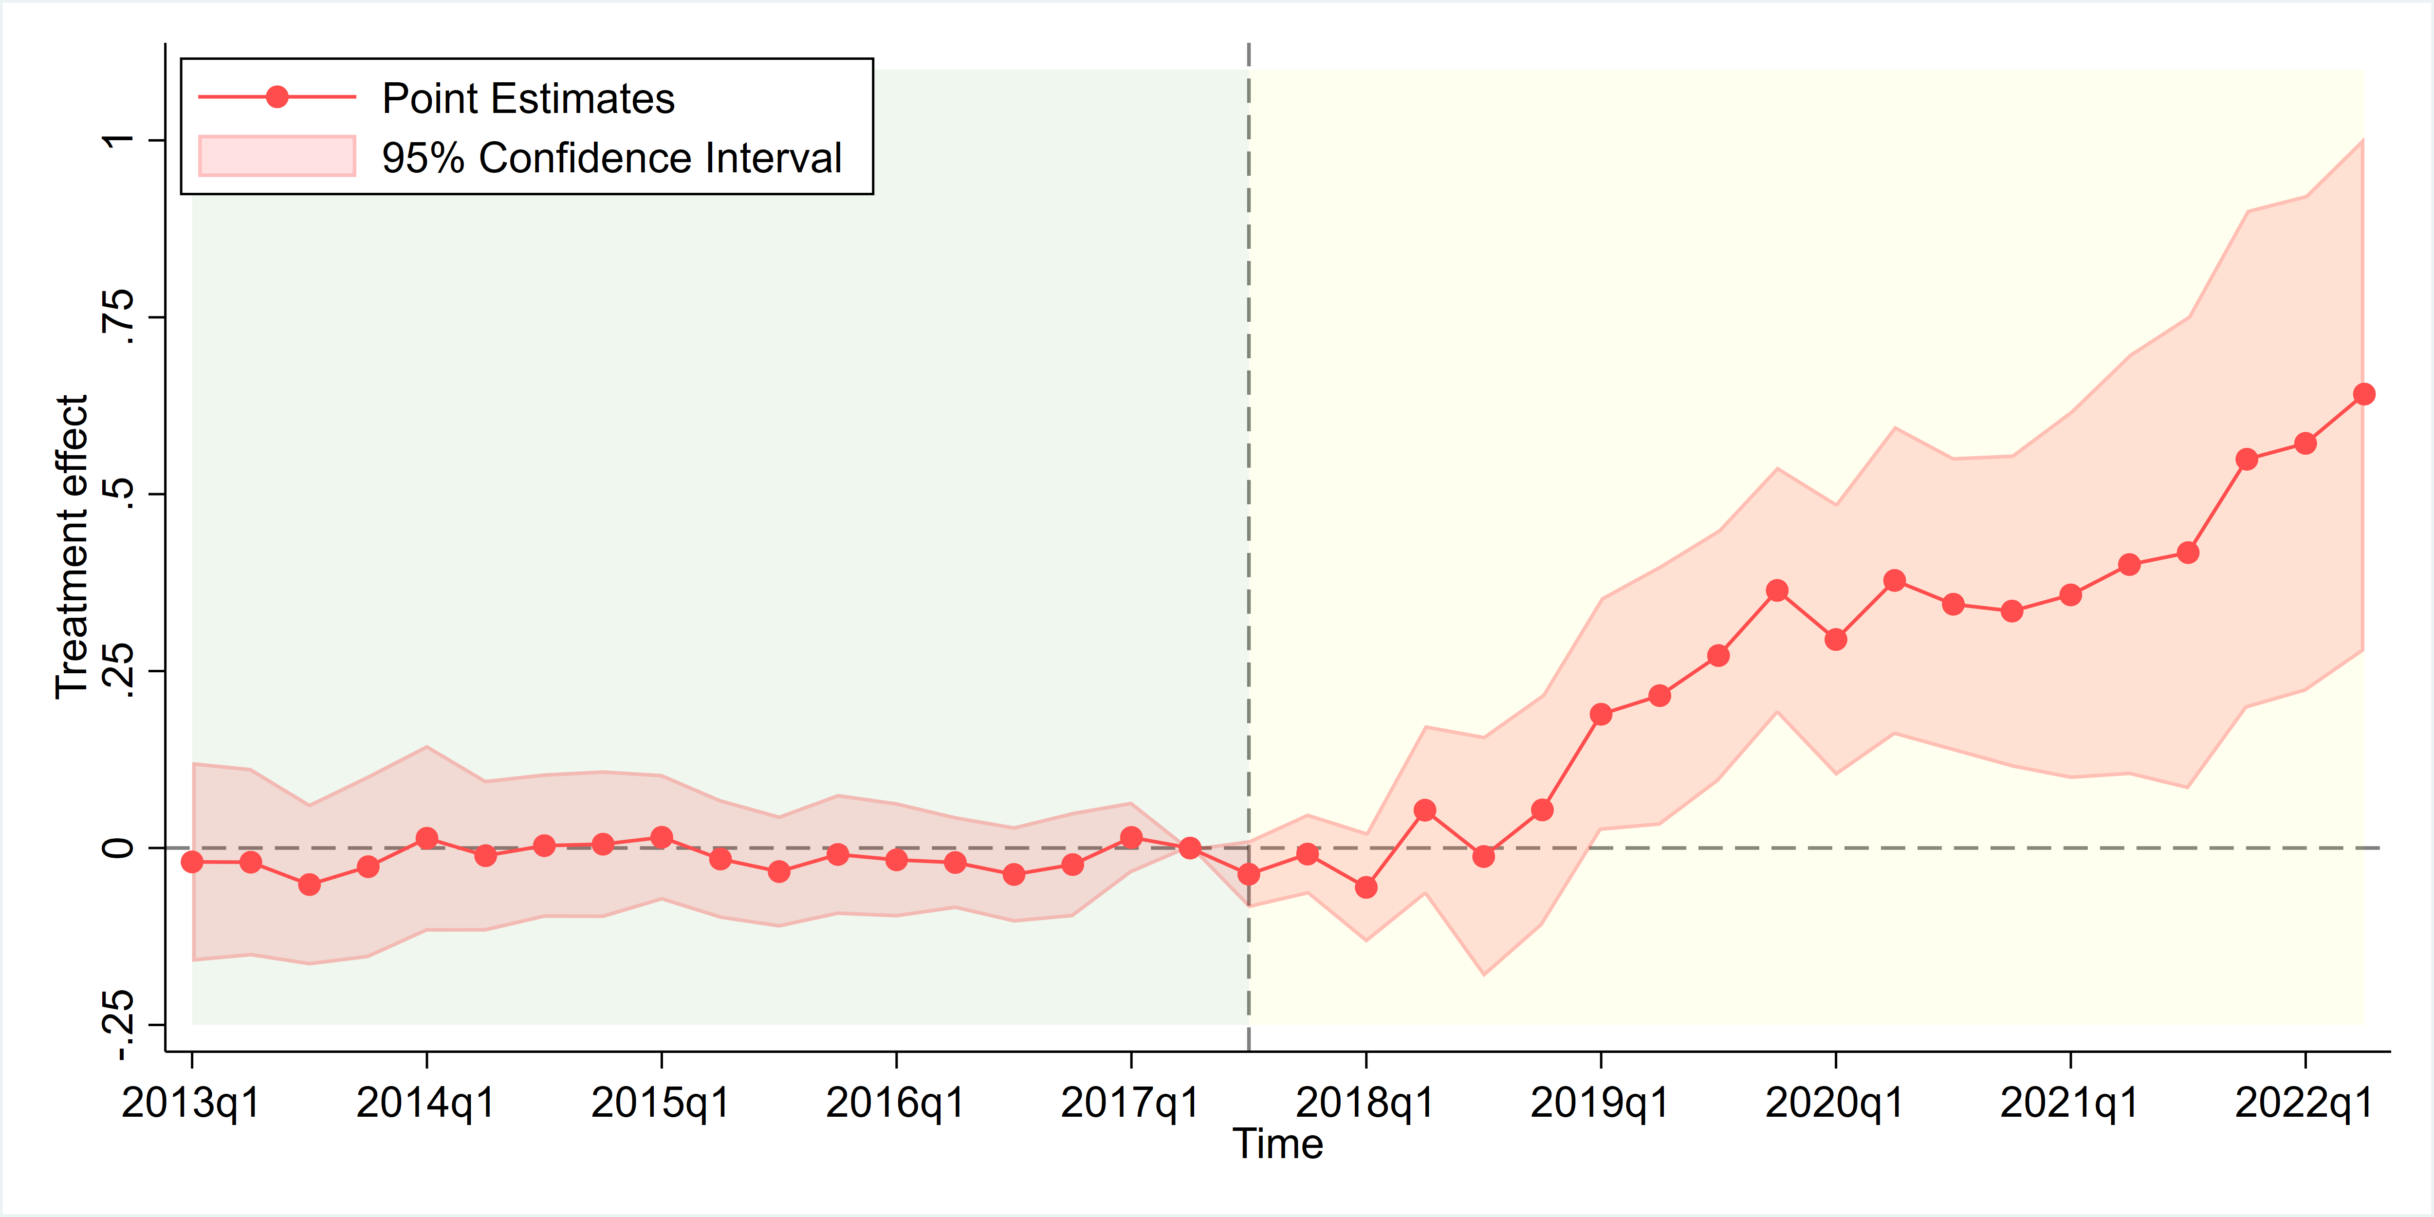
Event Study
$Spread_{bict}=δ_{ic}+λ_{t}+ \sum_{t}{β_{t}}NNR_{c}×Time_{t} +θX_{c}×Post_{t}+ γZ_{bict} + ε_{bict}$ (2)

Slide 12
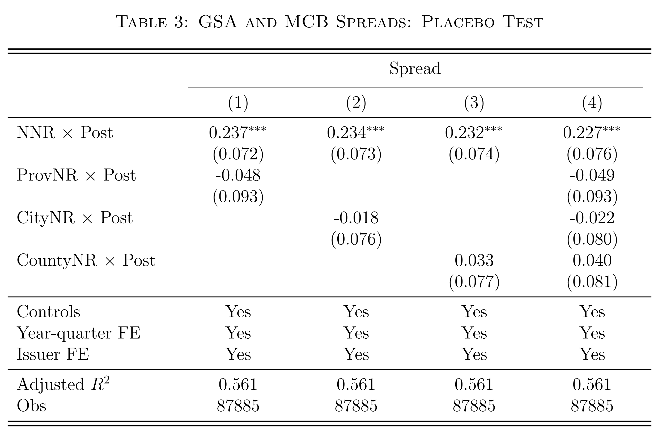
Placebo Tests
No significant effects for lower-level nature reserves.

Slide 13
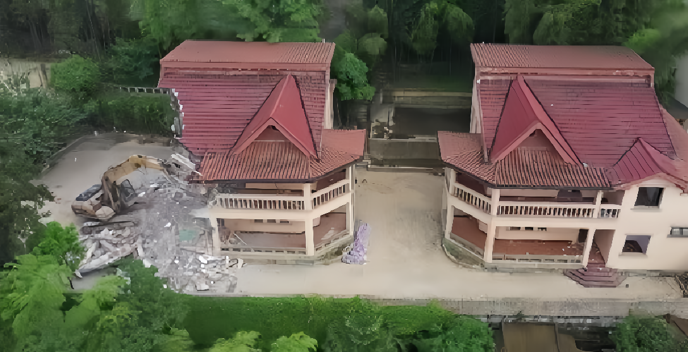
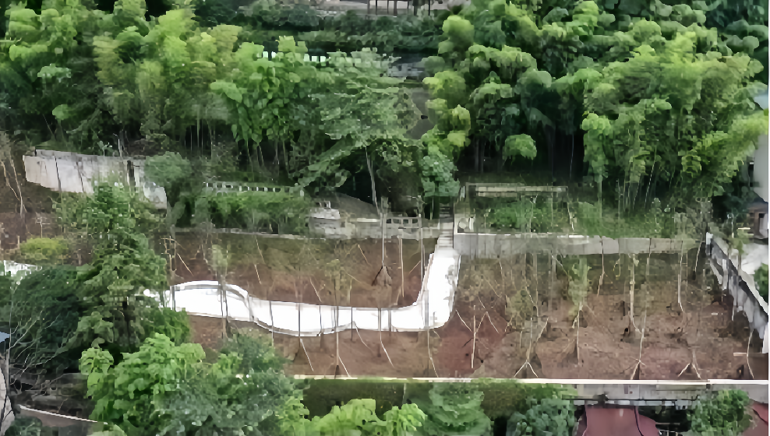
Mechanism - Transition Costs
Jinyun Mountain NNR in Chongqing
pre-GSA
post-GSA
Beibei District Govt spent over 440 mill. RMB in relocation effort.
fiscal revenue: mere 3 billion RMB for that year (≈15%).

Slide 14
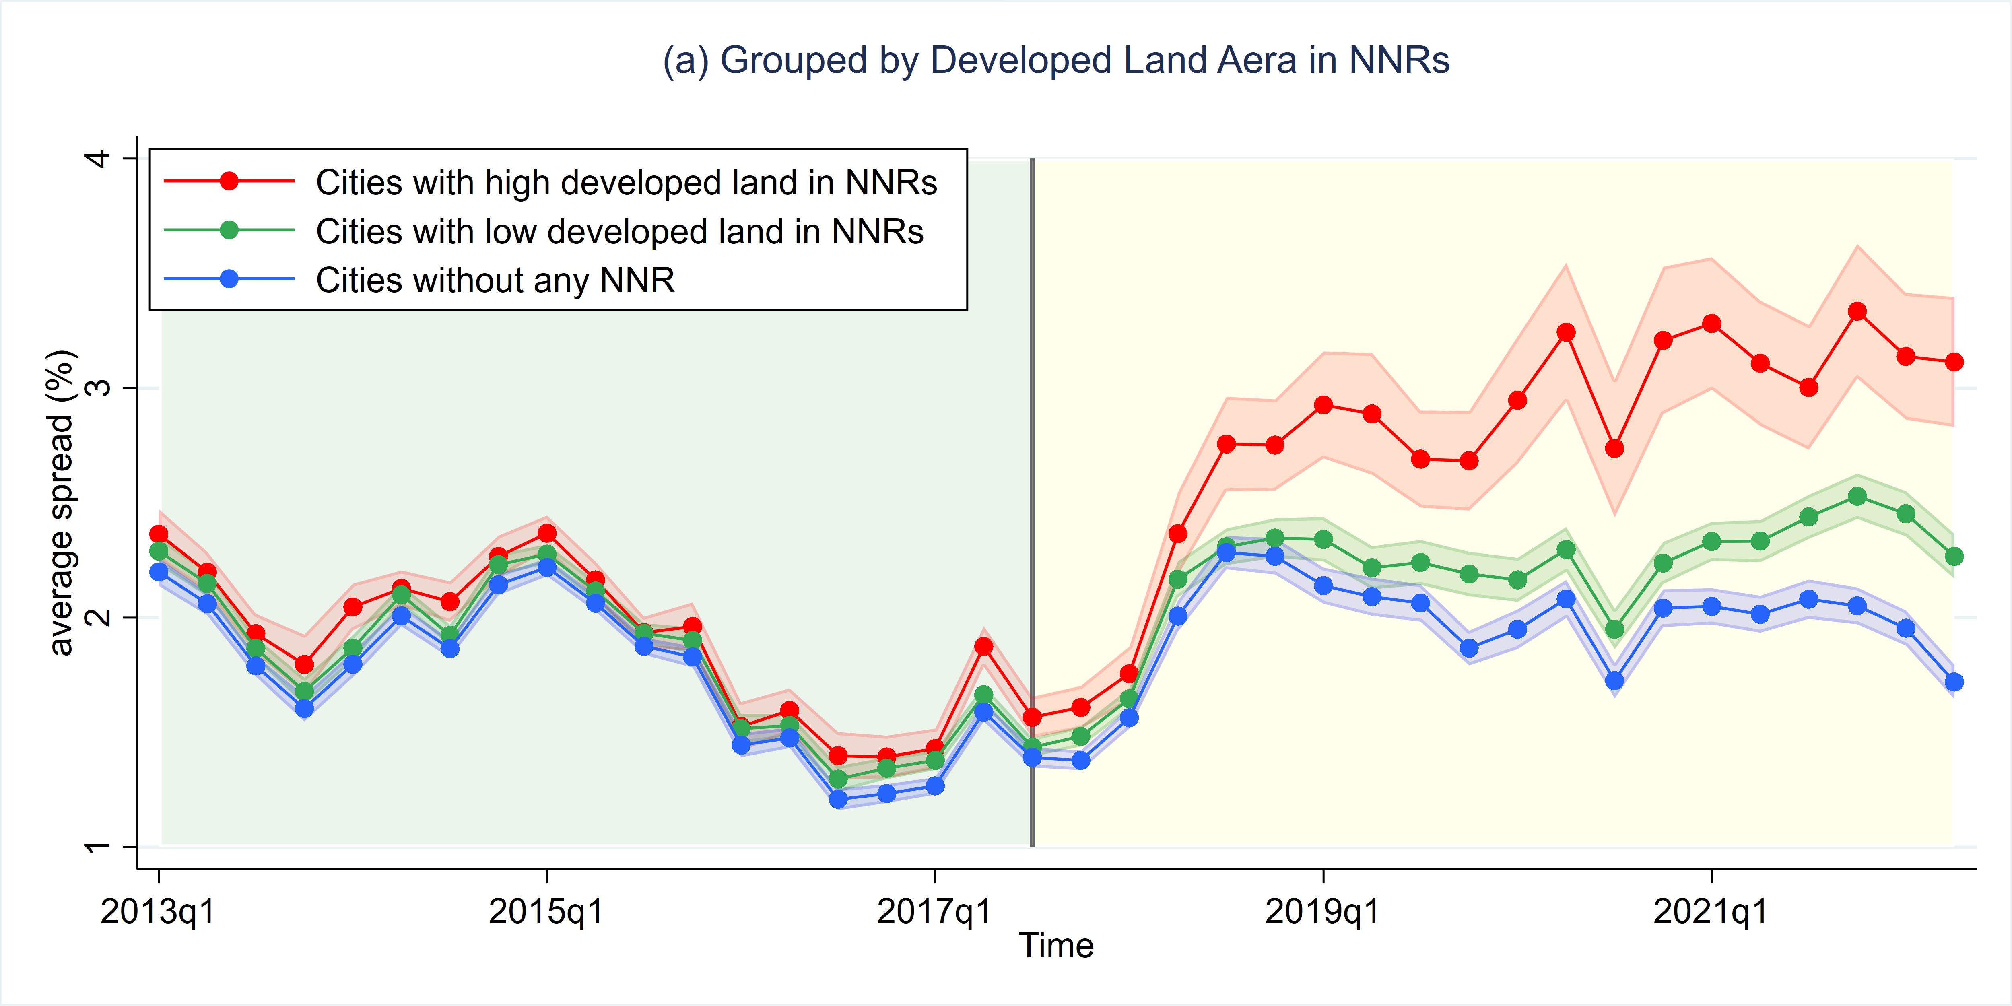
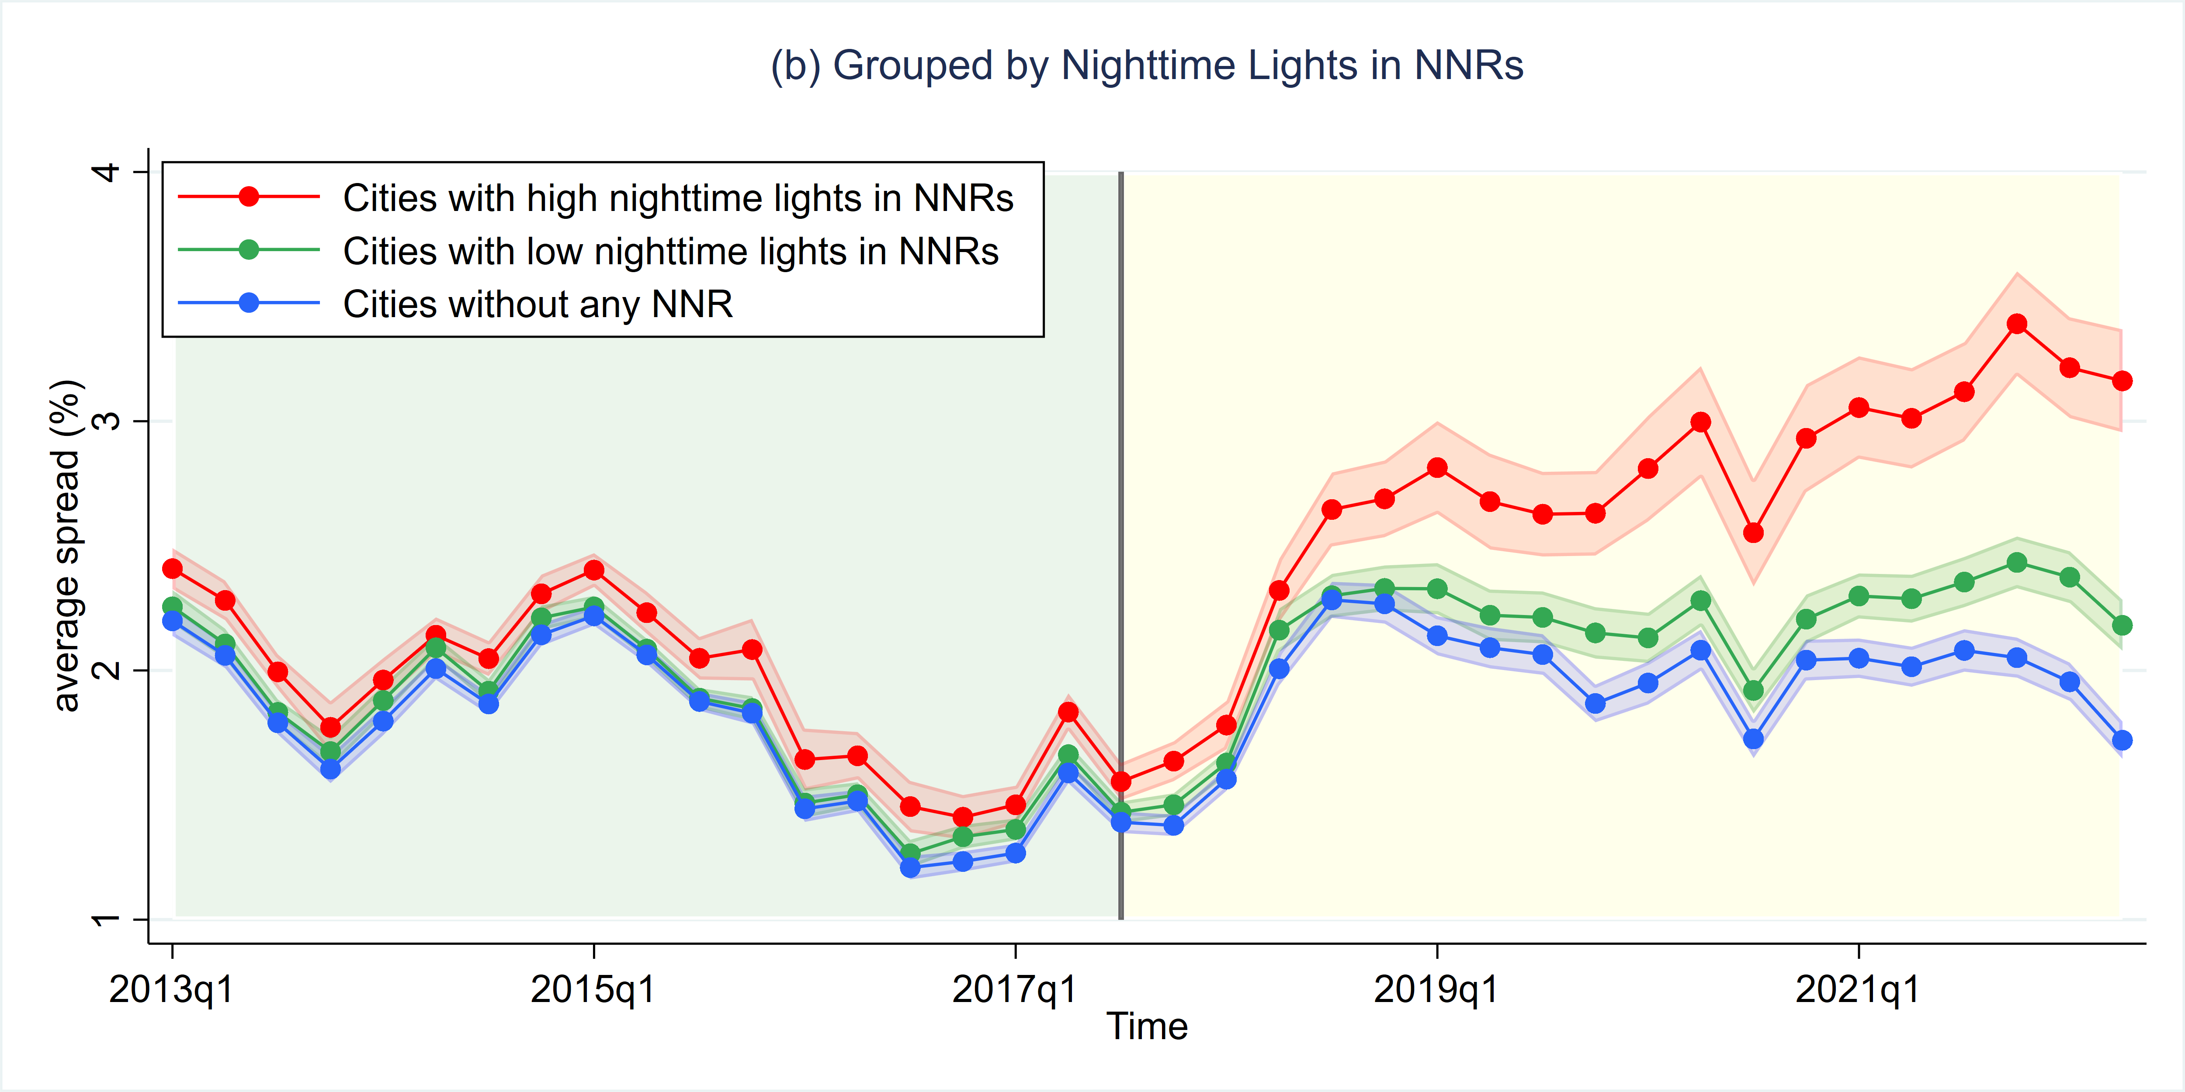
Pre-existing Economic Activities inside NNRs

Slide 15
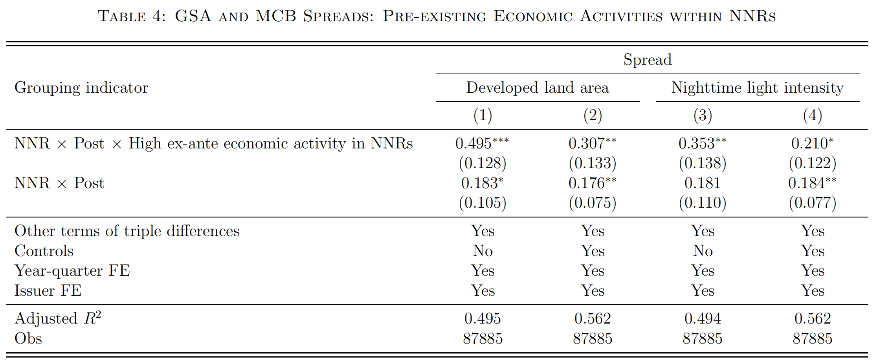
Pre-existing Economic Activities inside NNRs
Greater effects for cities with more pre-existing economic activities in NNRs

Slide 16
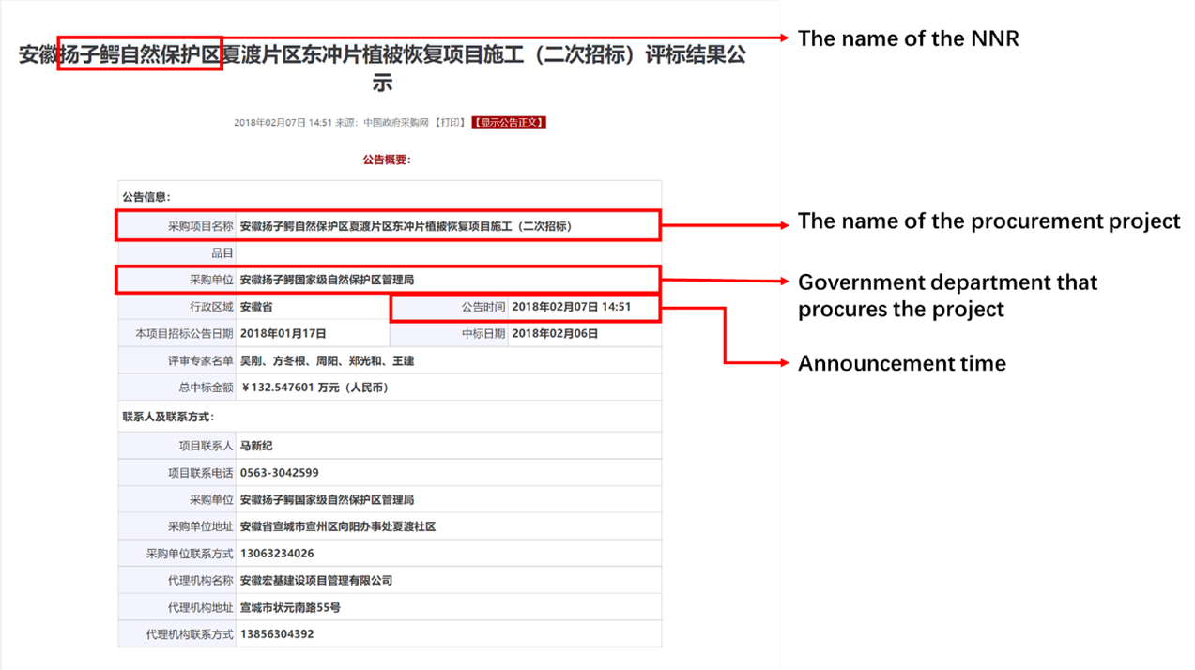
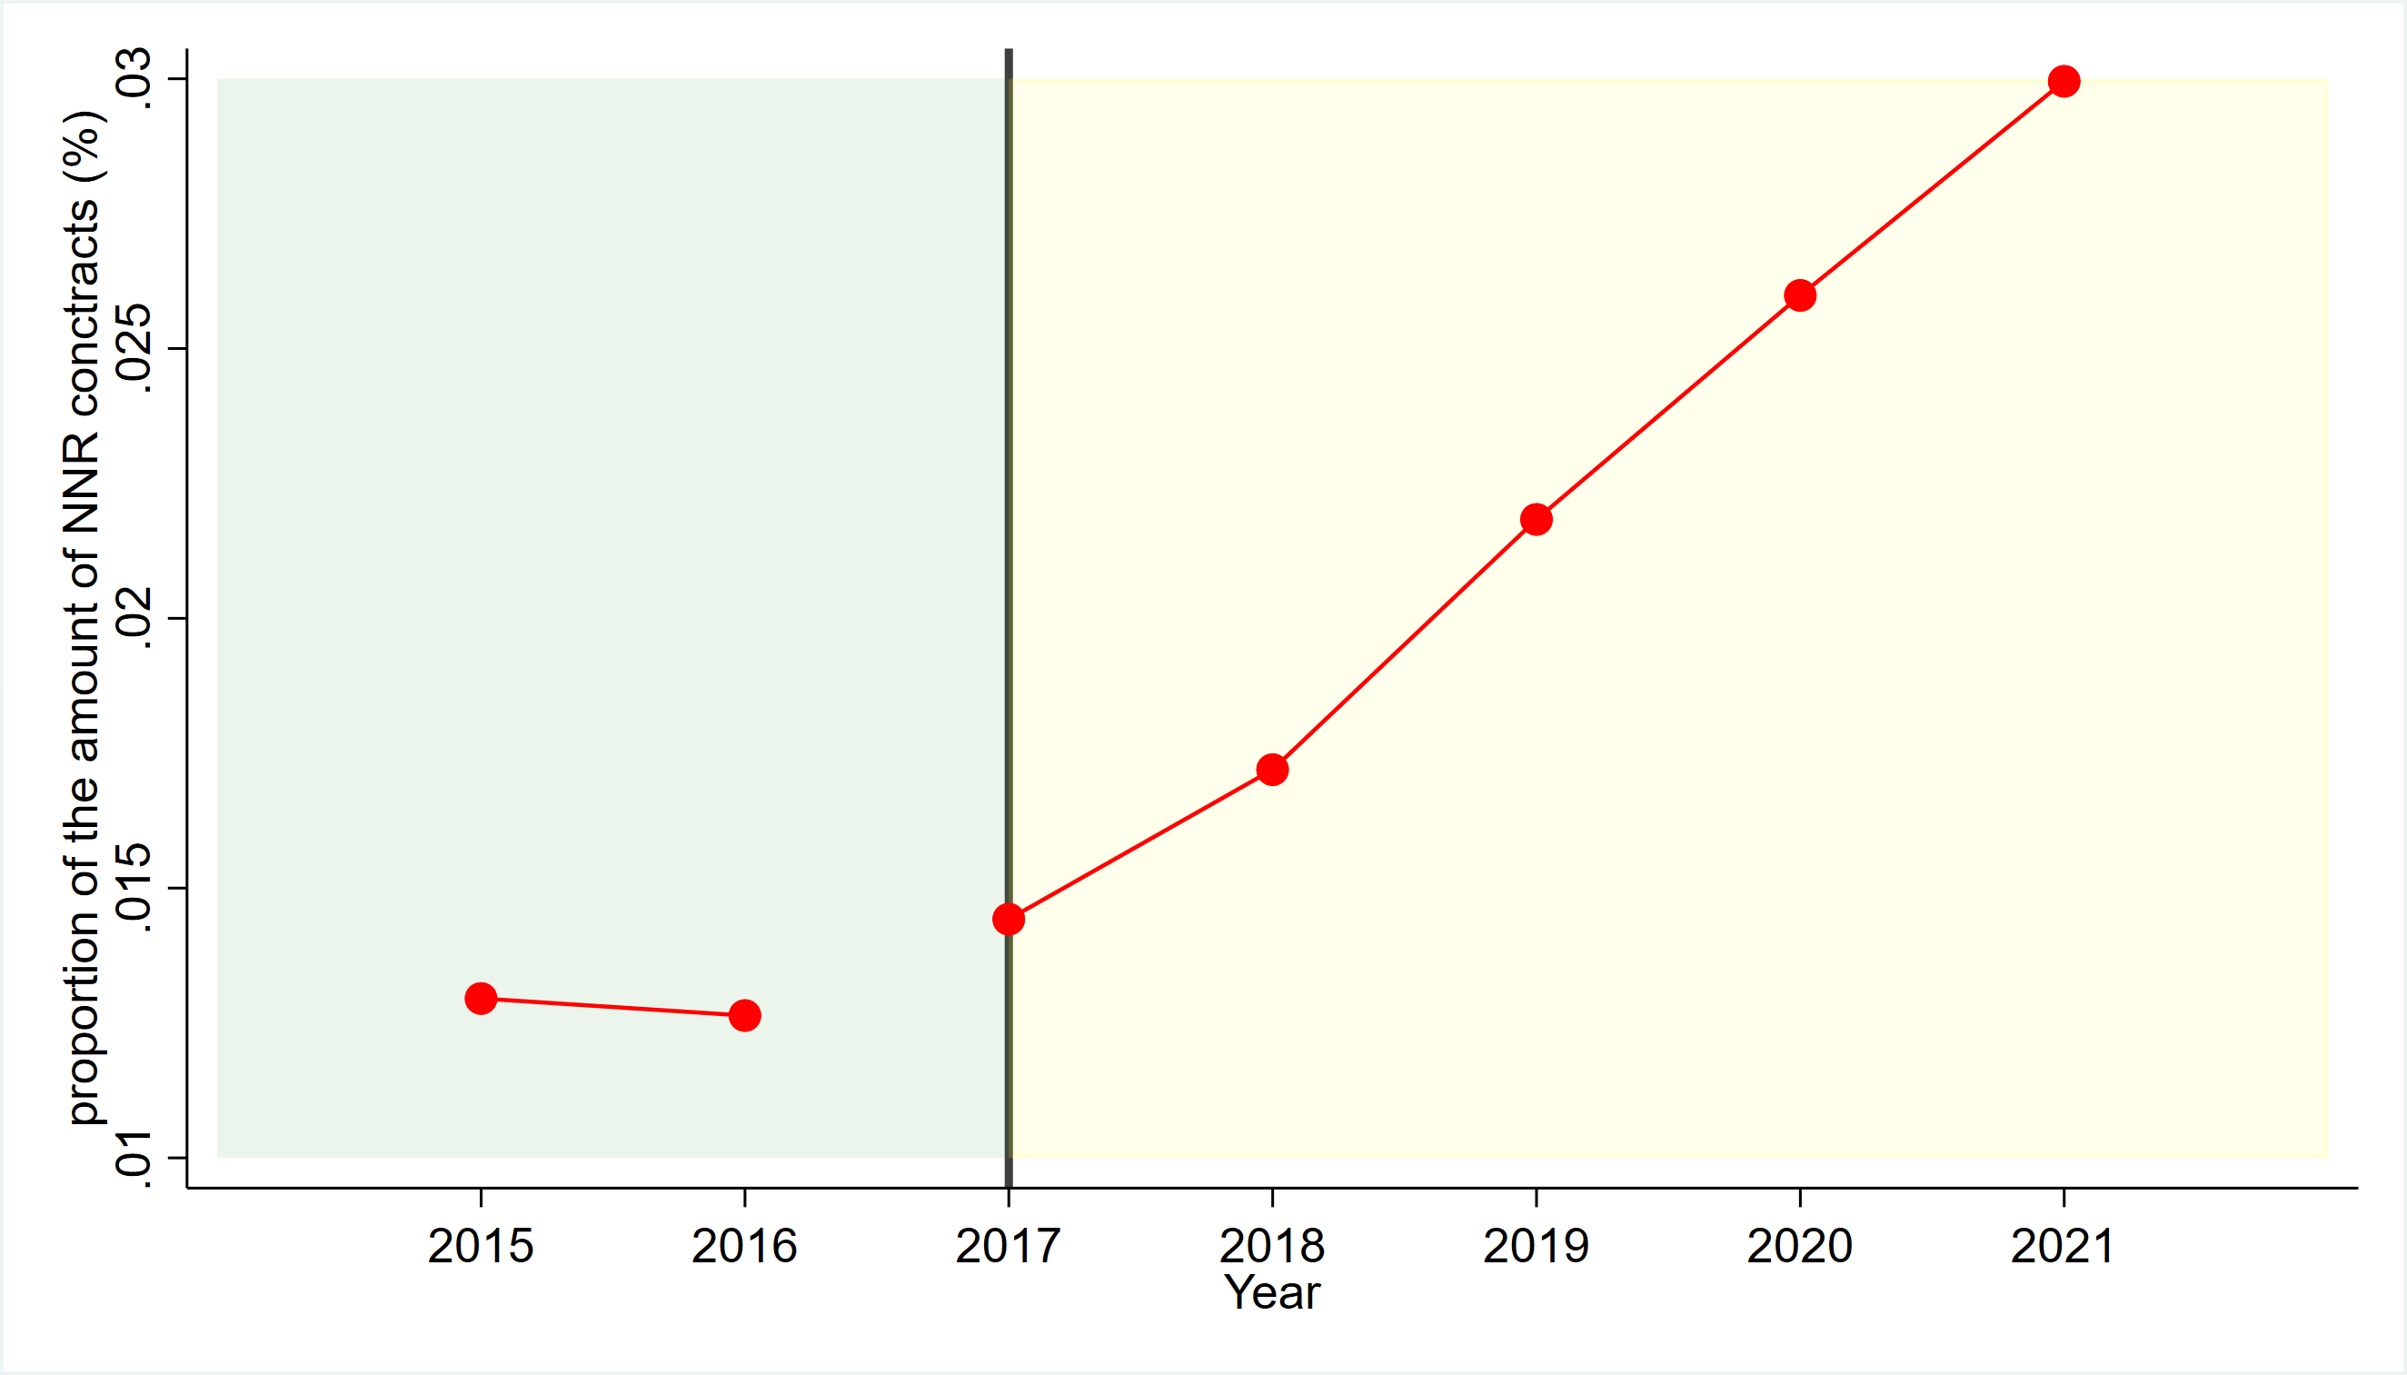
Actual Public Spending on Biodiversity

Slide 17
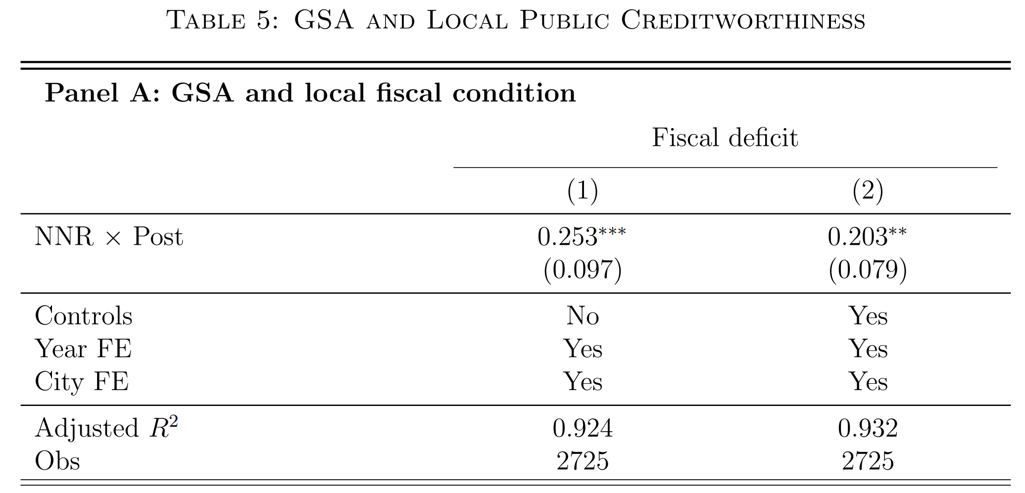
Local Public Creditworthiness
Worsen local fiscal condition

Slide 18
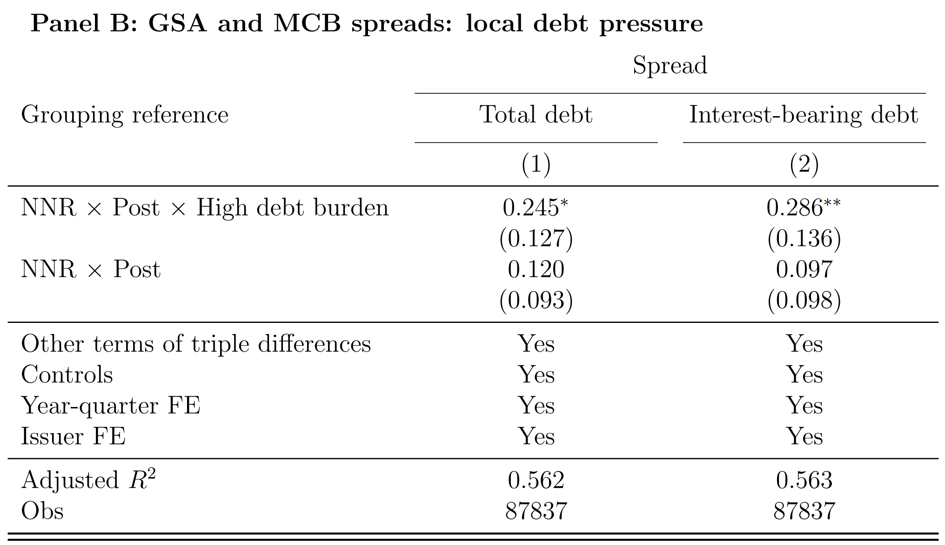
Local Public Creditworthiness
Greater effects for cities with higher debt burden.

Slide 19
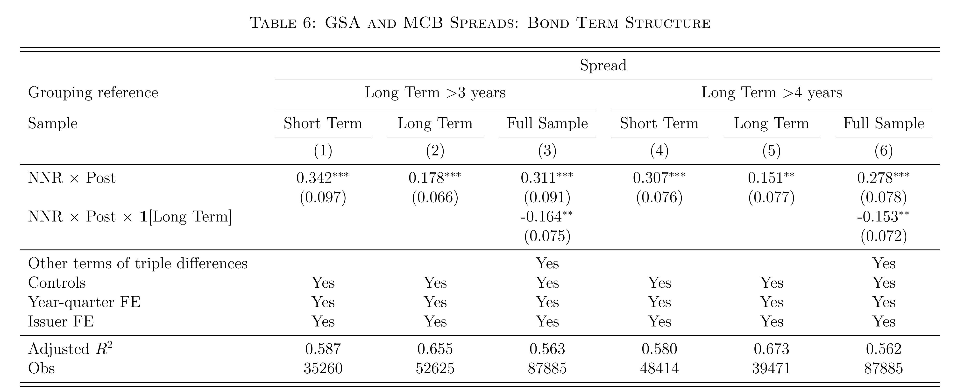
Heterogeneity - Bond Term Structure
Greater effects for bonds with shorter maturities

Slide 20
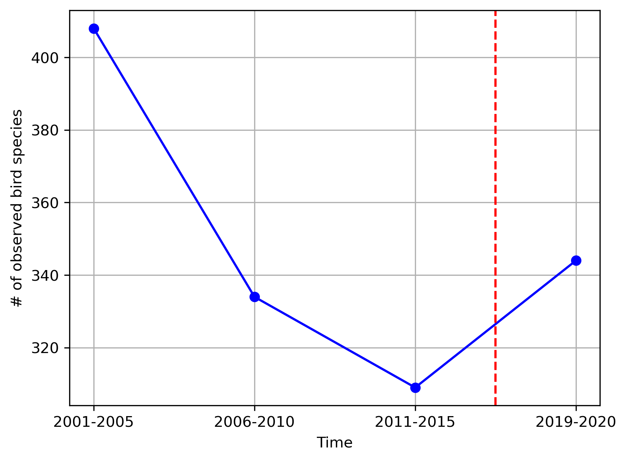
Biological Improvement
Observations from Ecological investigation stations inside eight NNRs.

Slide 21
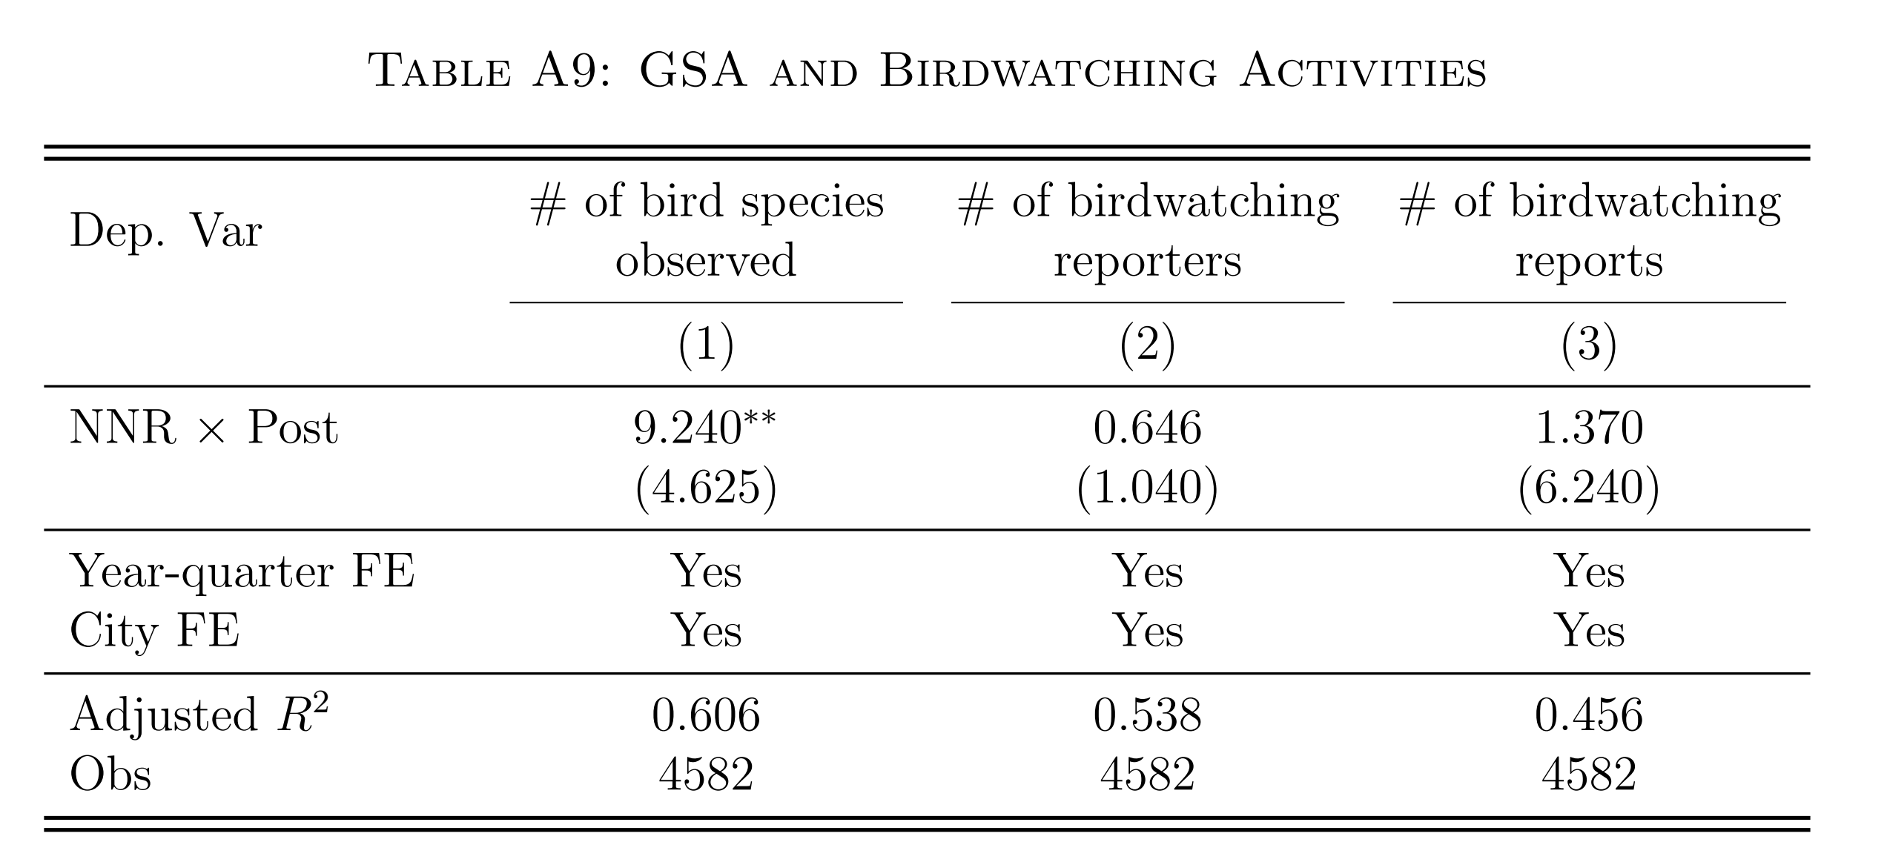
Biological Improvement

Slide 22
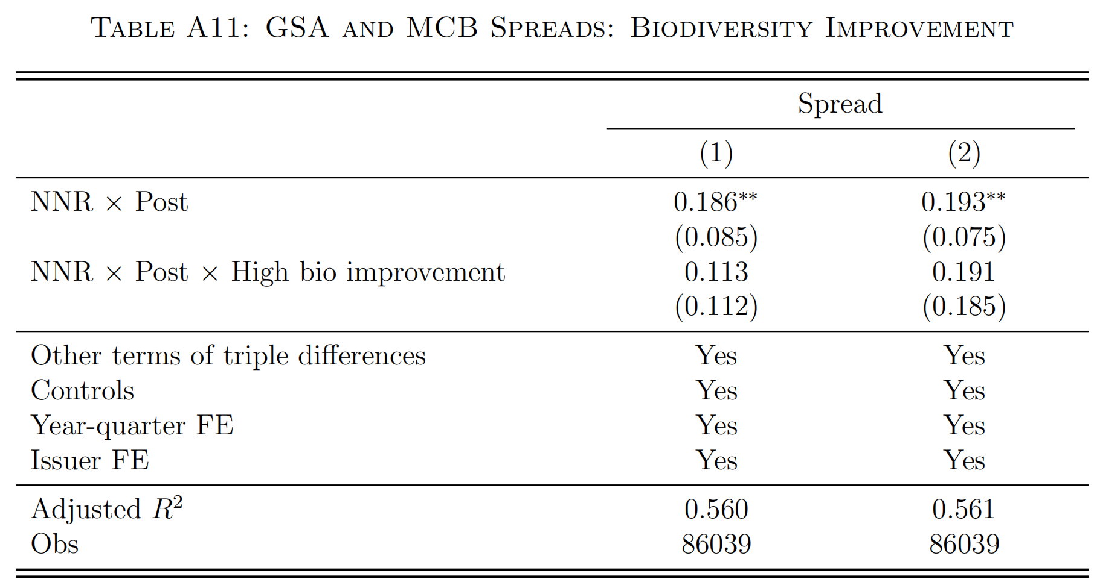
“Value” vs. “Values” – The Pricing Effects
Investors’ non-pecuniary preferences on sustainablity
do not favor effective biodiversity improvements
inconsistent with the heterogeneity in information disclosure
inconsistent with the insignificance among lower-level nature reserves

Slide 23
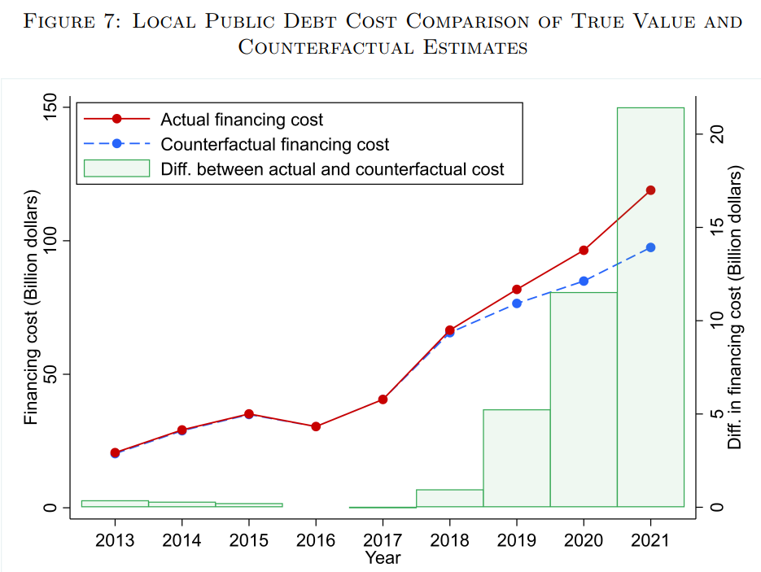
Additional Financing Costs
A back-of-the-envelope estimation of additional public financing costs (i.e., interest payment): ~40 billion dollars (2018-2021).

Slide 24
Literature
Nature capital & biodiversity conservation
The benefits of biodiversity conservation
"Value of diversity" (Weitzman, 1992,1993,1998); Heal (2001); Brock & Xepapadeas (2003).
reducing health risks (Frank & Sudarshan, 2023; Frank, 2021; Keesing & Ostfeld, 2021)
mitigating climate change (Isbell et al., 2015; Rizzi, 2022; Taylor & Druckenmiller,2022)
The costs of biodiversity conservation - limited evidence
This paper: public financing costs (context: a govt-led conservation effort)
Biodiversity & Financial Markets (emerging)
Recent work: Giglio et al. (2023), Garel et al. (2024), Coqueret et al. (2024), Xiong (2023)...
characterize the biodiversity risks faced by firms
risk premia in equity or derivatives markets
This paper: how the costs of biodiversity conservation are priced in bond markets in a large emerging economy of significance for global biodiversity transition

Slide 25
Literature
Sustainability & climate finance
Climate finance (Choi et al., 2020; Engle et al., 2020; Sautner et al., 2023; ……)
In contrast, biodiversity issues (Karolyi & Tobin-de la Puente, 2023):
more challenges in valuation and property rights .
harder to address through market mechanisms like carbon trading
Govt (public capital) engagement in conservation: necessary
⇒ raise concerns about govt’s fiscal sustainability.
This paper: significant effects on the cost of public capital
Impact investing
Financial benefits (“value”) & non-pecuniary preferences (“values”) (Starks, 2023)
“values” motivation (Baker et al., 2022; Barber et al., 2021)
“value” motivation (Giglio et al., 2023; Dimson et al., 2015, 2021; Krueger et al., 2020; Starks et al., 2023; Hoepner et al., 2024)
This paper: “value” motivation dominates in GSA.

Slide 26
Implications
External validity:
Biodiversity loss is a global issue
China: biologically & economically important (e.g., Egli et al., 2018)
Implications: “Government moving first” in biodiversity transition
limited budget + fiscal burden: expensive external financing (our finding)
optimal targeting
heterogeneity in biological benefit vs. financial cost
specialized financing instruments
adequate information disclosure
cultivation of ESG investors
social consensus of biodiversity conservation
⇒ “Blended” Biodiversity Finance (Flammer, Giroux & Heal, 2023, 2024)

Slide 27
Conclusions
GSA increased MCB spreads: by ~24 bps
Additional interest payments: Estimated ~$40 billion (2018-2021)
Potential mechanism
shutting down illegal economic activities within NNRs
expanding local public spending on NNRs
× not driven by (potentially) more public financing demand
× not driven by (potentially) higher local political risk
Heterogeneity: larger effects in
bonds with shorter maturities & local govts in weaker fiscal conditions
“Value” vs. “Values”
local biodiversity improved
pursuit of financial returns ＞ non-pecuniary preferences on biodiversity

Slide 28
Thanks！

