Slide 1
On the Importance of Assurance in Carbon Accounting
Florian Berg, Jaime Oliver, Roberto Rigobon

Slide 2
Two Challenges working with CO2 data
Voluntary disclosure (with or without assurance)
implying a strategic decision by the firm
Data coverage
80% of the data has been imputed

Slide 3
Science Based Target Initiative
Several steps in the Net Zero Target
Firms commit to set a target (takes about two years)
SBTI validates or not the “plan” (several firms are denied)

Slide 4
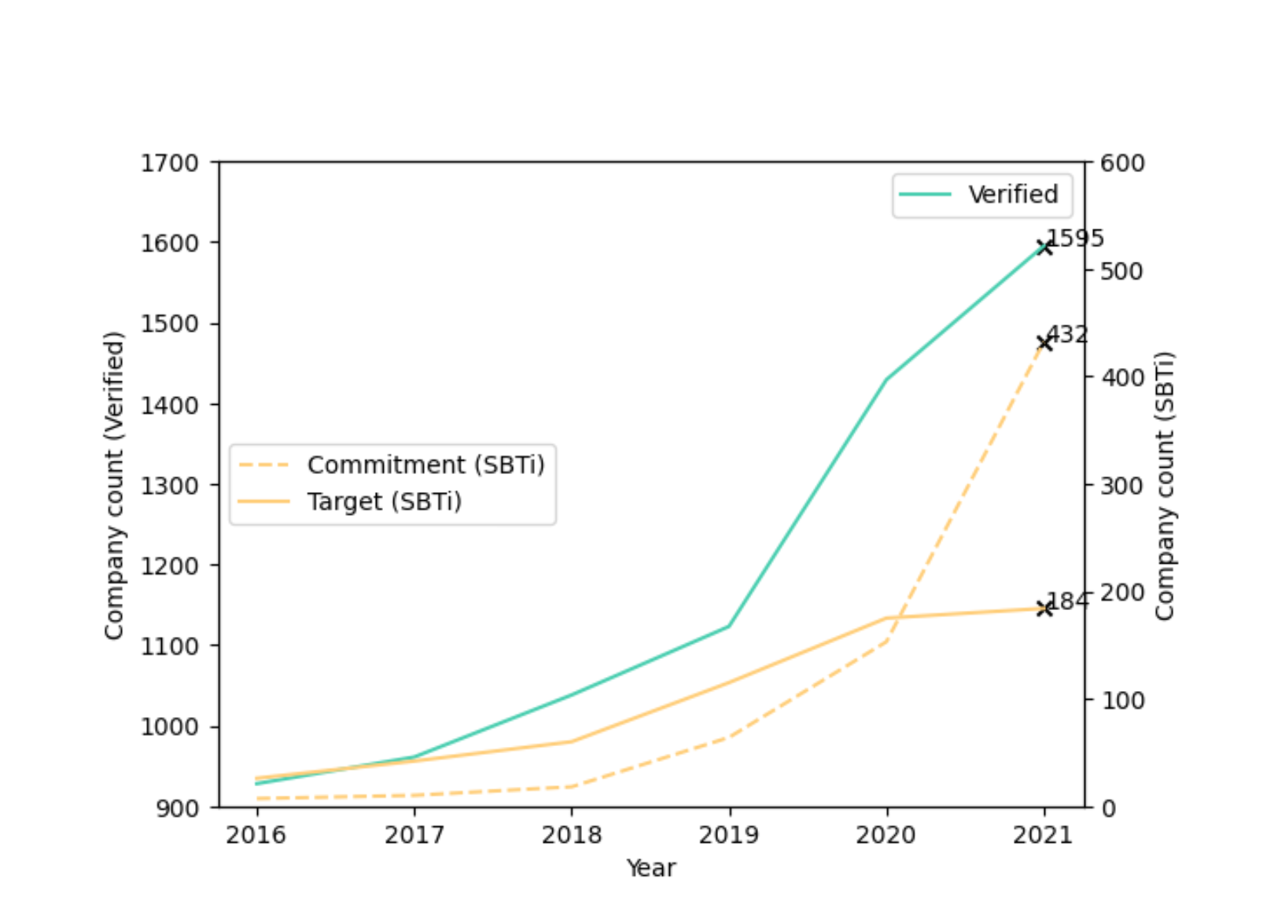
Sample

Slide 5
Path of emissions after assurance (% change)
Emission’s reduction
Increase due to the verification and assurance of emissions

Slide 6
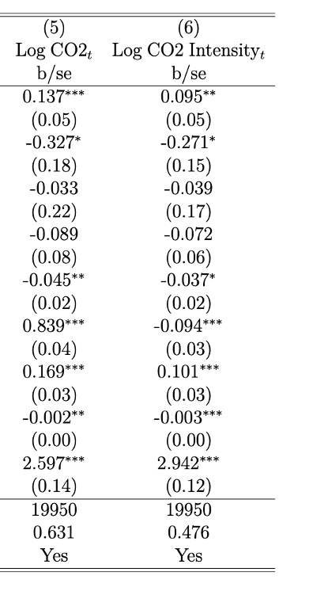
Transparency is costly

Slide 7
But the signal indicates future improvements

