Slide 1
Do financial advisors charge sustainable investors a premium?
Marten Laudi Paul Smeets Utz Weitzel
Notes:
The question of whether financial advisors engage in price discrimination against sustainable investors has been debated in the United States (US) and Europe.

Slide 2
Source: https://www.wsj.com/articles/tidal-wave-of-esg-funds-brings-profit-to-wall-street-11615887004
Source: https://www.economist.com/special-report/2022/07/21/how-to-charge-more
Notes:
The Wall Street Journal proclaimed sustainable investing the new cash cow, in which additional fees of around 6 basis points can be earned from passively managed sustainable exchange traded funds (ETFs) at no extra costs (Wursthorn, 2021). The Economist made similar claims that \although [sustainable investing practices] emerged in response to the preferences of investors, [...] asset managers have turned this to their advantage“ (Tricks, 2022). – They show the presence of mutual funds with essentially the same hodldings, where those that claim to be sustainable charge significantly higher fees. – This is of course only anecdotal evidence.
This debate has gained momentum after a recent amendment to the MiFID II regulation in the European Union. This amendment mandates financial advisors to elicit their clients' socially responsible investing (SRI) preferences.

Slide 3
Our paper
Do financial advisors charge higher fees to clients who communicate a preference for sustainable investing?
If yes,
Compensation for higher costs, skill, or effort
Higher gains from trade
Price discrimination
Notes:
We hypothesize that this is the case. We bring together two streams of literature:
Socially responsible investors are willing to pay higher fees (Riedl and Smeets, 2017).
Professional money managers are ready to exploit preferences of investors for financial gains (Cooper, Gulen, & Rau, 2005).
…a compensation for higher costs, skill or effort?
… or exploitation of preferences ?

Slide 4
The experiments
Two lab-in-the-field delegated choice experiments.
Sample of 415 professional financial advisors, as well as clients.
Recommend equity funds to clients.
Recommend single stocks to clients.
Notes:
I will focus on the European experiment in my presentation, but all results hold for the US experiment as well.

Slide 5
Why an experiment?
Causal identification: We exogenously vary investor mandates (sustainable or conventional) and observe how this affects the fees charged by financial advisors.
Observe unobservables: Are potentially higher fees driven by additional required effort, skill, costs, or higher gains from trade?
We include important contextual elements to ensure external validity (Gneezy & Imas, 2016; Harrison & List, 2004).
Notes:
Maybe

Slide 6
Experimental design
Advisors
Recommend funds
Sustainable unknown financial literacy
Sustainable
low
financial literacy
Sustainable
high
financial literacy
Conventional unknown financial literacy
Conventional
low
financial literacy
Conventional high
financial literacy
Random order
Fee 1
Fee 2
Fee 3
Fee 4
Fee 5
Fee 6
Notes:
Then we can see how much the same advisor charges to different types of clients. Clients could also reject the fee and select a fund on their own.

Slide 7
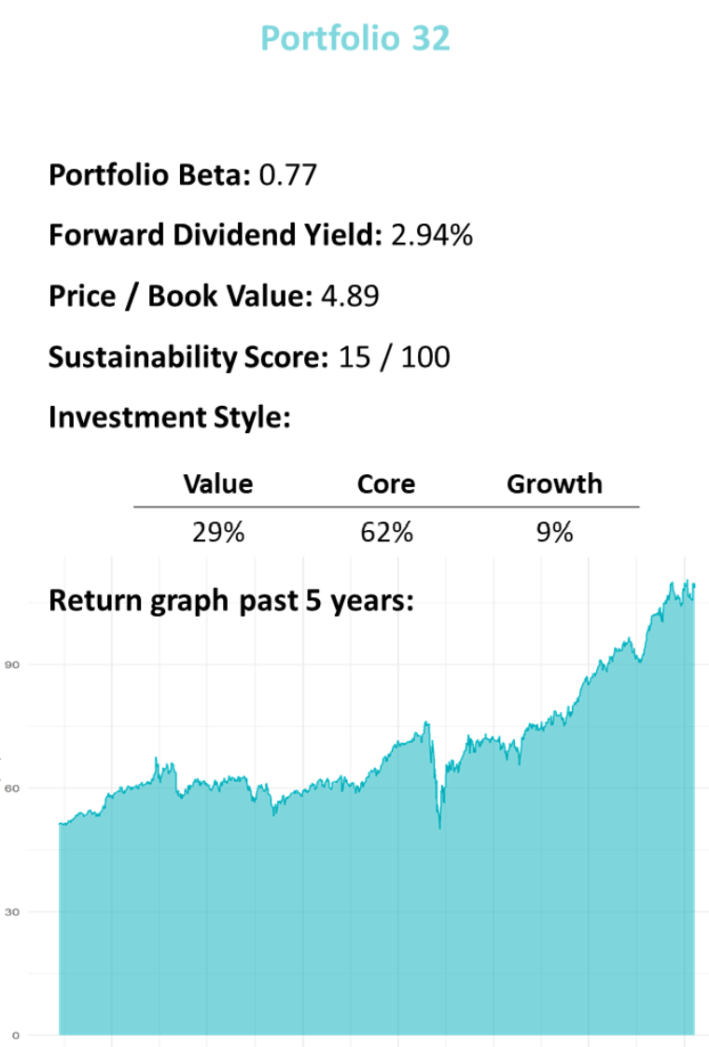
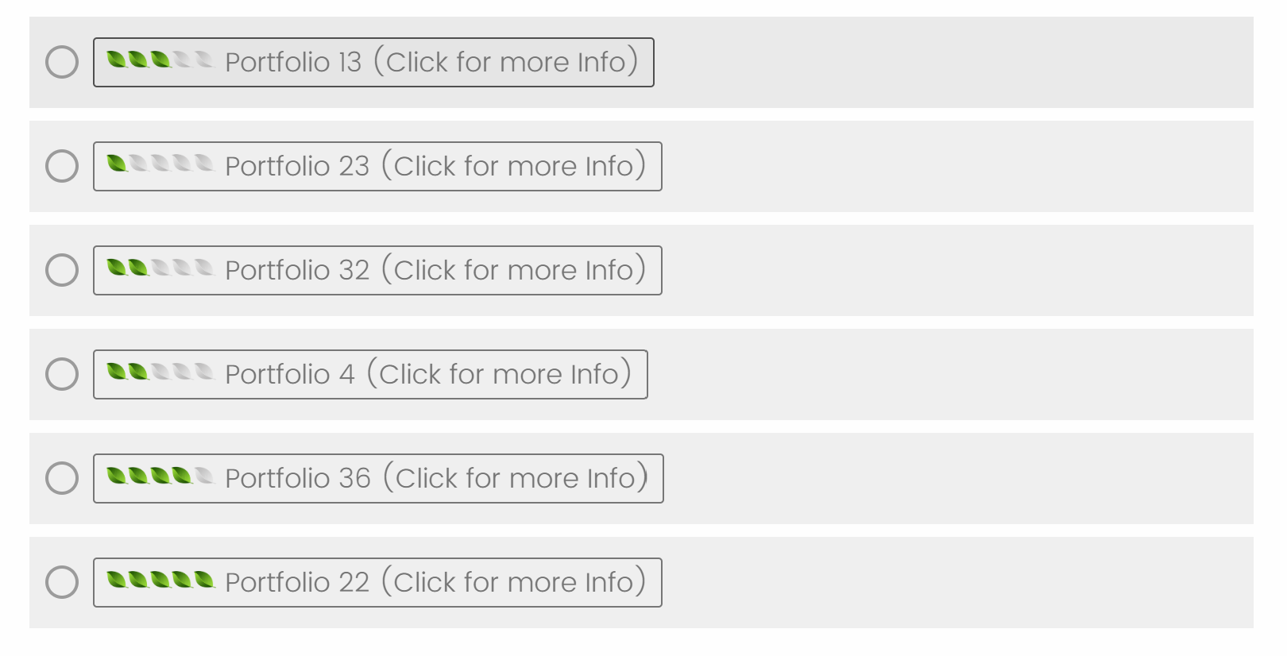
Notes:
Client profiles are randomized, but balanced across mandates and gender.

Slide 8
Results
Notes:
First, I will show you whether we can replicate our original findings.

Slide 9
Financial advisors charge higher fees for sustainable fund selection.
Sustainable
Additional fees of between 7.7 and 8.3 basis points
Sustainable investors are 18.5 percentage points more likely to be charged a higher fee.
If the premium is charged, it is 42.4 basis points, on average.
Less time and effort for sustainable investors.
Financial Literacy
Low |  | Unknown |  | High
Notes:
Source: https://www.efama.org/sites/default/files/files/Asset%20Management%20Report%202021_5.pdf

Slide 10
Advisors charge the highest fee to sustainable investors with low financial literacy.
Sustainable
Additional fees of between 7.7 and 8.3 basis points
Sustainable investors are 18.5 percentage points more likely to be charged a higher fee.
If the premium is charged, it is 42.4 basis points, on average.
Less time and effort for sustainable investors.
Financial Literacy
Low |  | Unknown |  | High
Notes:
Source: https://www.efama.org/sites/default/files/files/Asset%20Management%20Report%202021_5.pdf

Slide 11
Advisors do not charge sustainable investors with high financial literacy a higher fee.
Sustainable
Additional fees of between 7.7 and 8.3 basis points
Sustainable investors are 18.5 percentage points more likely to be charged a higher fee.
If the premium is charged, it is 42.4 basis points, on average.
Less time and effort for sustainable investors.
Financial Literacy
Low |  | Unknown |  | High
Notes:
Source: https://www.efama.org/sites/default/files/files/Asset%20Management%20Report%202021_5.pdf

Slide 12
Similar sustainable fee premium in archival data
WSJ (2021): Passively managed sustainable ETFs have around 6 basis points higher fees.
Aragon et al. (2022): University endowment funds investing sustainably pay 7.7 basis points higher fees.
Baker, Egan, and Sarkar (2022): Financial intermediaries capture around 5.9 basis points higher fees from sustainable index funds.
Notes:
A back-of-the-envelope analysis suggests that, in 2020, individual/retail SRI clients paid excess fees of at least $2.23 billion in the US alone. If we apply the same premium to all US funds using SRI strategies (including institutional investors), excess fees in 2020 were $8.38 billion. Even if our effect size is just an indication we consider this premium to be economically meaningful.

Slide 13
Fee difference as price discrimination?
No cost difference
No skill difference
We measure and control for effort differences
No higher gains from trade

Slide 14
Clients are not more likely to reject advice
 | DV: Was the Advice Taken?
 | US |  | Europe
Sustainable Investment Mandate | 0.035 | 0.041 | 0.311*** | 0.316***
 | (0.180) | (0.184) | (0.221) | (0.230)
High Financial Literacy |  |  |  | -0.080
 |  |  |  | (0.262)
Fee |  | 0.018 |  | -0.026
 |  | (0.094) |  | (0.128)
Female |  | 0.035 |  | 0.070
 |  | (0.183) |  | (0.229)
High Age |  | 0.030 |  | 0.042
 |  | (0.186) |  | (0.229)
High Income |  | -0.010 |  | -0.102
 |  | (0.182) |  | (0.227)
α | 0.389*** | 0.319 | 0.086 | 0.145
 | (0.123) | (0.261) | (0.147) | (0.371)
Observations | 208 | 208 | 157 | 157
Pseudo R2 | 0.00 | 0.01 | 0.16 | 0.20

Slide 15
How do advisors perceive sustainable investors?
We elicit advisors’ perceptions about their clients
in a separate survey (incentivized).
Limited financial understanding
Willing to accept lower net return to satisfy social preferences
Notes:
Financial advisors do not perceive sustainable investors to have lower financial literacy, lower fee literacy, or less investment experience. So they do not believe that their clients do not understand fees.
money to help others without expecting anything in return.
However financial advisors believe that sustainable investors are more willing to give to good causes without expecting anything in return.

Slide 16
Conclusion
Advisors charge sustainable investors a higher fee
Replicates for American and European advisors
Replicates in variations of the experimental setting
Less time and effort spent on sustainable investors
SRI clients are not less likely (in the US) or even more likely (in Europe) to pay for advice
Premium not extracted when clients signal high financial literacy
Advisors believe that sustainable investors are willing to give up return to satisfy social preferences

Slide 17
Thank you for your attention

