Slide 1

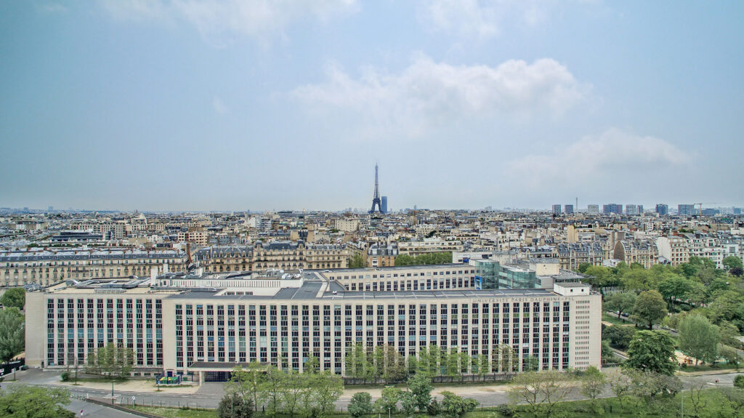

25.08.2025 / 9h00 - 18h00
AMPHI ARON, 2nd Floor
GRASFI ANNUAL
CONFERENCE

Slide 2


Thank you!
GRASFI ANNUAL
CONFERENCE

Slide 3
25.08.2025 / 9h00 - 18h00
AMPHI ARON, 2nd Floor
GRASFI prize for Best PhD Research paper
goes to
“Firm Operations, Biodiversity Loss, and Corporate Disclosure”
by
Atreya Dey
GRASFI ANNUAL
CONFERENCE

Slide 4

25.08.2025 / 9h00 - 18h00
AMPHI ARON, 2nd Floor
prize for
Best Data and Metrics in Sustainable Finance and Investment Research
goes to
“Biodiversity Co-Benefits in Carbon Markets? Evidence from Voluntary Offset Projects”
by
Zoey Yiyuan Zhou and Douglas Almond
GRASFI ANNUAL
CONFERENCE

Slide 5

25.08.2025 / 9h00 - 18h00
AMPHI ARON, 2nd Floor
GRASFI ANNUAL
CONFERENCE
prize for Best Paper goes to
“Pricing Pollution: Asset-Pricing Implications of the EU Emissions Trading System”
by
Joop Huij, Dries Laurs, Philip Stork, and Remco Zwinkels

Slide 6
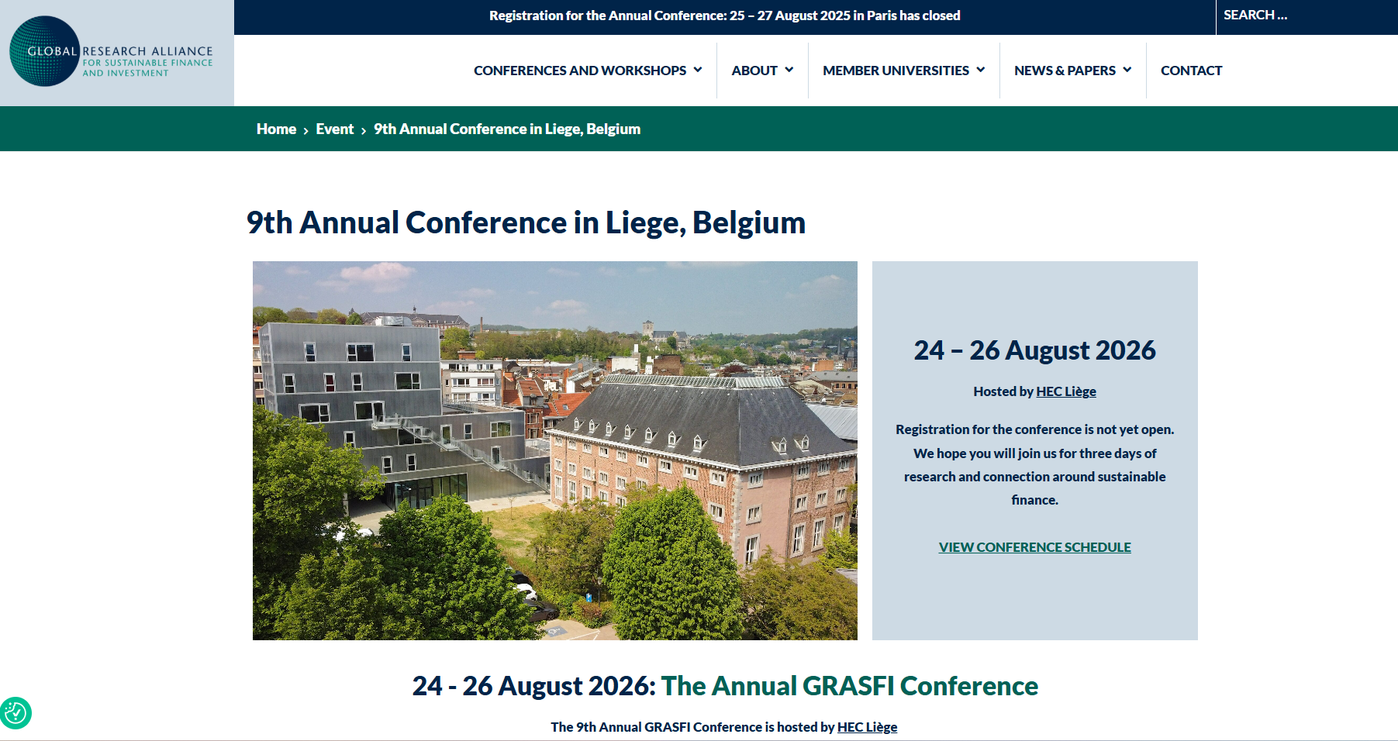

Slide 7
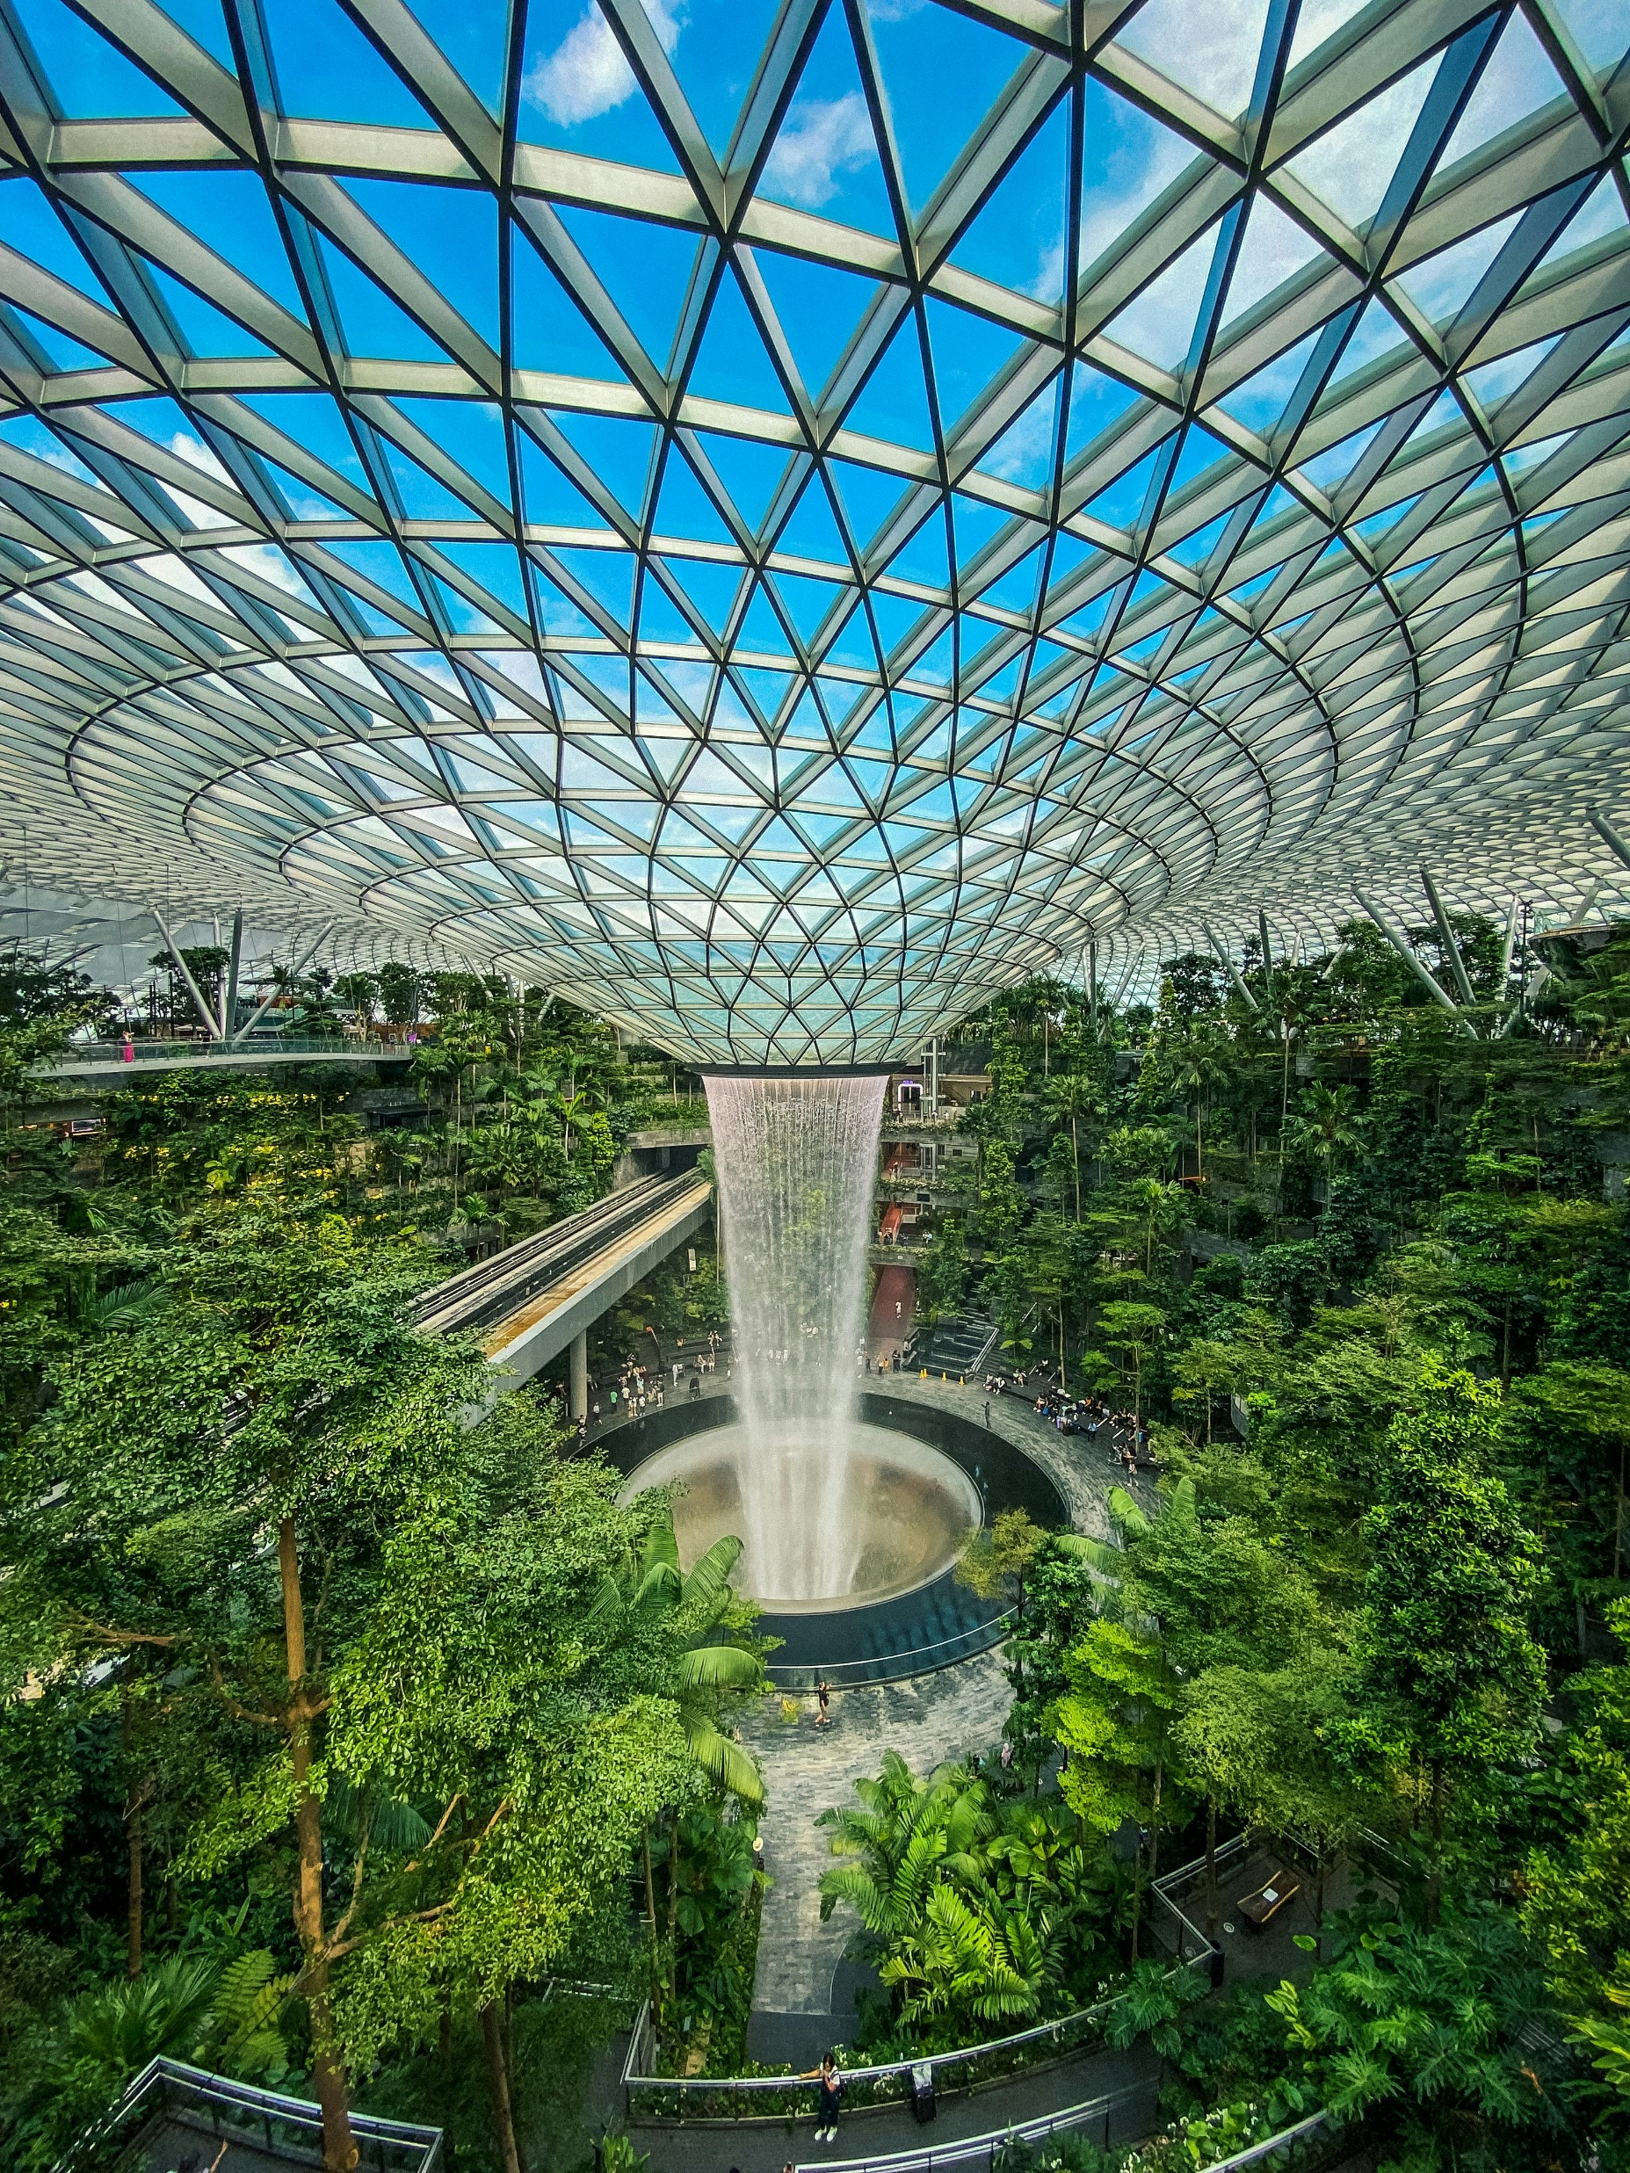




Save the Date
2-4 December
Advancing Sustainable Finance and Investment Research in Asia
ORGANISED BY
HOSTED BY

