Slide 1

PhD Workshop - GRASFI
Borderless Leadership for a Sustainable Future: TMT Nationality Diversity and the Path to Low-Carbon Innovation
Sompassorn Ruksomboonde
Singapore Management University
17 September 2025
1

Slide 2

Multi-Stakeholder Pressure Drives Corporate Green Transformation
Regulatory Mandates Governments worldwide are implementing mandatory climate-related disclosure requirements. (Carattini et al., 2022; Cong et al., 2020)
Consumer Expectations
Market demand shifts toward and rewards companies showing authentic environmental responsibility (Hosta & Zabkar, 2021; Vadakkepattet al., 2021)
Investor Capital Flows
ESG criteria now drive capital allocation decisions by investors (Jin,
2022; Kräussl et al., 2024; Zhang et al., 2024)
2
Motivation
Contribution
Theoretical framework
Data
Result
Conclusion
Future improvement
Notes:
Regulator
The European Union has been the most proactive in this domain, issuing a proposal for a directive on improving the gender balance on corporate boards as early as 2012.8 Currently, as of January 2022, eight EU member-states have adopted binding quotas for board gender diversity: Belgium, Italy, Portugal, Germany, Austria, France, the Netherlands, and Greece. Another ten states have resorted to soft and non-binding quotas: Denmark, Estonia, Ireland, Spain, Luxembourg, Poland, Romania, Finland, Slovenia, and Sweden.9 The UK has also put in place soft quotas. Beyond Europe, India issued the Companies Bill in 2013 which requires public companies to have at least one woman director. Malaysia adopted a policy in 2011 for companies with more than 250 employees to have boards that are at least 30% women by 2016. Brazil is still looking into a quota for state and mixed-cap companies, which would require them to have boards that are at least 30% women by 2022.10 These efforts are certainly going to improve the diversity of corporate boards while bringing the companies under regulatory scrutiny
Investor
responsible investors are actively embracing investing with a gender lens, thereby aligning their strategies with the UN Sustainable Development Goals, and pushing companies to have greater gender diversity. In 2019, total publicly available equity and fixed income offerings in gender lens investing reached over USD 2.4 billion in assets under management. The push to integrate gender diversity in investment criteria has increased over the years: at least 15 new publicly traded gender lens equity funds have been launched since 2015. In 2017, Morgan Stanley encouraged analysts to include gender scores in their investments, while in 2018 the State Street Global Advisors announced that it would vote against all-male boards in the US, UK, and Australia as of 2020. In 2018, BlackRock announced that it expected the companies it invested in to have at least two women on the board and urged the Russell 1000 companies under that minimum to act on their lack of diversity

Slide 3




Why does nationality diversity in TMT matter?
Nationality Diversity has become increasingly important nowadays
EY survey on Diversity Equity and Inclusion (DEI) in 2024
Leadership teams are still not diverse enough.
Only 40% of top managers from underrepresented groups, while 61% for non-managerial employees.
Mandates/Proposals on nationality diversity in workplace
The European Banking Authority (EBA) encourages broader diversity.
Workplace fairness legislation in Singapore: prohibit workplace discrimination.
The Canadian government proposed new diversity disclosure regulations.
3
Motivation
Contribution
Theoretical framework
Data
Result
Conclusion
Future improvement
Notes:
Regulator
The European Union has been the most proactive in this domain, issuing a proposal for a directive on improving the gender balance on corporate boards as early as 2012.8 Currently, as of January 2022, eight EU member-states have adopted binding quotas for board gender diversity: Belgium, Italy, Portugal, Germany, Austria, France, the Netherlands, and Greece. Another ten states have resorted to soft and non-binding quotas: Denmark, Estonia, Ireland, Spain, Luxembourg, Poland, Romania, Finland, Slovenia, and Sweden.9 The UK has also put in place soft quotas. Beyond Europe, India issued the Companies Bill in 2013 which requires public companies to have at least one woman director. Malaysia adopted a policy in 2011 for companies with more than 250 employees to have boards that are at least 30% women by 2016. Brazil is still looking into a quota for state and mixed-cap companies, which would require them to have boards that are at least 30% women by 2022.10 These efforts are certainly going to improve the diversity of corporate boards while bringing the companies under regulatory scrutiny
Investor
responsible investors are actively embracing investing with a gender lens, thereby aligning their strategies with the UN Sustainable Development Goals, and pushing companies to have greater gender diversity. In 2019, total publicly available equity and fixed income offerings in gender lens investing reached over USD 2.4 billion in assets under management. The push to integrate gender diversity in investment criteria has increased over the years: at least 15 new publicly traded gender lens equity funds have been launched since 2015. In 2017, Morgan Stanley encouraged analysts to include gender scores in their investments, while in 2018 the State Street Global Advisors announced that it would vote against all-male boards in the US, UK, and Australia as of 2020. In 2018, BlackRock announced that it expected the companies it invested in to have at least two women on the board and urged the Russell 1000 companies under that minimum to act on their lack of diversity

Slide 4
Main research question
Is there any link between TMT nationality diversity and corporate carbon emission?
New fresh perspective on sustainability and innovation
Create conflict in opinion and lead to lower efficiency.
VS
What are the reasons for the above relationship?
4
Motivation
Contribution
Theoretical framework
Data
Result
Conclusion
Future improvement

Slide 5

Contribution
New empirical insights into how TMTs with cross-national diversity embed sustainability into organizational processes and strategic decision-making systems.
The study strengthens causal inference through a multi-method empirical strategy that combines cross-sectional regressions, a Difference-in-Differences (DiD) design, and an Instrumental Variables (IV) approach.
The study reveals three organizational pathways—green innovation, sustainable operations and responsible supply chain practices, as well as sustainability-oriented governance mechanisms.
5
Motivation
Contribution
Theoretical framework
Data
Result
Conclusion
Future improvement

Slide 6
Theoretical framework
The Upper Echelons Theory
Institutional Theory
The Resource-Based View
1
2
3
Reframe cross-national diversity as a valuable intangible resource (Barney, 1991)
The characteristics of the top management team influence organizational outcomes.
(Hambrick and Mason,1984).
The need for firms to adapt to diverse regulatory and normative environments. (DiMaggio & Powell, 1983)
Main Hypothesis: Higher TMT nationality diversity helps reduce corporate carbon emissions.
6
Motivation
Contribution
Framework & Hypothesis
Data
Result
Conclusion
Future improvement

Slide 7
Main Hypothesis
Main Hypothesis : Higher TMT nationality diversity leads to lower corporate carbon emission (expect negative sign for β₁)
Carbon_emission_{i,t} = β_{0i} + β₁Nationality_Diversity_{i,t} + β₂Control_var_{i,t} + FE + ε_{i,t}
Number of distinct TMT nationality/ total members of TMT
Carbon emission level (direct, indirect) and carbon intensity
7
Motivation
Contribution
Framework & Hypothesis
Data
Result
Conclusion
Future improvement

Slide 8

Main Hypothesis
Supporting literature
TMT nationality diversity plays a role in establishing CSR focus (Sven Dahms, 2021).
Foreign institutions reduce the carbon emissions of their investee companies (Cao, Zhan, Zhang, 2023).
Board nationality diversity is positively associated with corporate social performance (Harjoto et al., 2019).
The presence of foreign directors on the board has been linked to enhanced carbon emission disclosures and performance (Lahyani, 2022; Hossain et al., 2017).
7
Motivation
Contribution
Framework & Hypothesis
Data
Result
Conclusion
Future improvement

Slide 9
Data and Methodology
Data
Worldwide data between 2002–2019 from BoardEx, S&P Global Trucost, USPTO, Eikon, Bloomberg, and Sustainalytics
Methodology
- Linear regression model (with fixed effects) to baseline and mechanism hypothesis.
- Linear probability model, Probit and Logit for a certain mechanism hypothesis.
- DiD and IV for robustness check
DID
- Regulation S-K in 2009 that requires the disclosure of directors’ experience and firms’ consideration of director diversity on the boards (US).
- CEO death.
IV
- Number of country immigrant/total population.
10
Theoretical Framework
Result
Result
Motivation
Hypothesis
Main question
Framework & Hypothesis
Contribution
Contribution
Literature
Data & method
Data & Method
Conclusion
Future improvement

Slide 10

What is Top Management Team (TMT)?
Organizational Structure
Board of Director
Top Management Team
C-level, President, Vice-president
Middle level management
General Manager, Regional Manager
First-line management
Manager, Supervisor, Team leader
2
Theoretical Framework
Result
Result
Motivation
Hypothesis
Main question
Framework & Hypothesis
Contribution
Contribution
Literature
Data & method
Data & Method
Conclusion
Future improvement

Slide 11
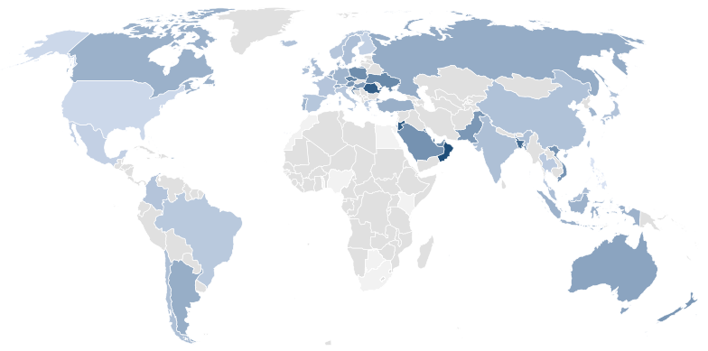

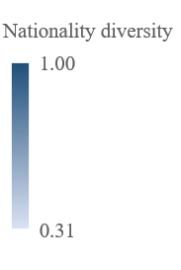
Statistics on TMT nationality diversity
Global map of TMT nationality diversity
Continent | Diversity Mean
Asia | 0.47
Australia and Oceania | 0.6
Europe | 0.5
North America | 0.37
South America | 0.44
World | 0.44
Data is unavailable
11
Theoretical Framework
Result
Result
Motivation
Hypothesis
Main question
Framework & Hypothesis
Contribution
Contribution
Literature
Data & method
Data & Method
Conclusion
Future improvement
Notes:
Canada
In 2023, Canada plans to grant permanent residency (PR) to 465,000 immigrants through various programs. Canada's PR targets for 2024 and 2025 are 485,000 and 500,000, respectively.
Getting a Canadian visa is not only easy but also cheaper compared to most other developed countries.
Its most popular immigration programs are:
The Express Entry program.
The Entrepreneur Program.
The Provincial Nominee Program (PNP).
The Federal Skilled Worker Program (FSWP).
Because of the benefits that Canada offers to immigrants, such as its health insurance program, Medicare, and subsidized and free healthcare and education, immigrants' major worries are taken care of.it is also a safe country with low crime rates.
Australia
Australia provides foreign nationals of certain countries' working holiday' visas, allowing them to reside on its shores for one year. It also issues Australian work visas to foreign workers who pass its SkillSelect assessment test.
Australia is one of the best countries for immigrants to settle in because of factors such as living standards, safety, and subsidized healthcare. Its work-life balance ranks among the best in the world.
Aspiring immigrants can choose Australia to opt for work exchange openings. Australia's efficient visa rules make it a very accessible country for foreign nationals to work there.
The Netherlands
The Netherlands is one of the easiest countries in the world to get a work visa. To encourage more foreign nationals, it has lowered taxes for them. Its standard of living ranks among the top in the world.
Foreigners intending to commence business in the Netherlands can obtain a one-year visa. After it lapses, they are eligible to apply for a self-employed work permit.
New Zealand
Because of its smooth visa processes and fewer requirements from foreign nationals, New Zealand is one of the favorite countries for immigrants seeking to work there. The country's natural environs and vibrant outdoor recreational activities are a plus.
Through the Skilled Migrant Visa of New Zealand and its Entrepreneurship Work Visa, you can enter the country. It also offers a working holiday visa, allowing foreign nationals to stay in the country for up to one year.
Singapore
The prosperous tiny island nation in Asia, Singapore, offers skilled foreign professionals the Expertise Pass and Overseas Networks. With Expertise Pass, migrants can earn a lot and enjoy convenient life in Singapore.
Singapore work visas are also offered to migrants who want to work there or opt to be self-employed. As it is one of the world's top financial hubs, Singapore offers job opportunities in diverse fields such as information technology, hospitality, and education. The weather in this country is also pleasant.
Ireland
Ireland welcomes skilled migrants to come and work there. It also provides Ireland work visas, also known as a Critical Skills Employment Permit, for people with special skills. Most of the jobs in this European country are available in its largest cities of Dublin and Cork. It also has become home to more multinational firms that sponsor international workers.
You'll have the best luck getting a job in Dublin, Limerick, and Cork. An increasing number of global firms will be able to sponsor you. Natives of Ireland are also accommodating and friendly.
South Korea
It is quite easy to find jobs in South Korea. This Southeast Asian nation is more inexpensive than most. It offers the E-2 visas certified English teachers reasonable compensation. It also offers visas for those who are 'looking for work' and 'working holiday,' with which they can work in global firms or the service sector.
Czech Republic
The Czech Republic offers international workers various career opportunities. Its capital Prague is a major financial center. This Central European country offers 'employment' visas to immigrants prior to their entry into the country. It is also possible to land in the Czech Republic on a tourist or a travel visa and get a job.
Most immigrants in the Czech Republic are employed in the sectors of Information and communication technologies (ICT), hospitality, healthcare, education, and social work.
The UK
The United Kingdom (UK) offers to skilled migrants Skilled Worker Visas. Individuals can apply for these if they get a job offer in a skilled profession in the UK. The in-demand jobs in this north-western European nation are IT professionals, healthcare workers, sales and marketing professionals, and scientists, among others.
If you want to work abroad, contact Y-Axis, a premier overseas career consultancy, to make it into a reality.

Slide 12
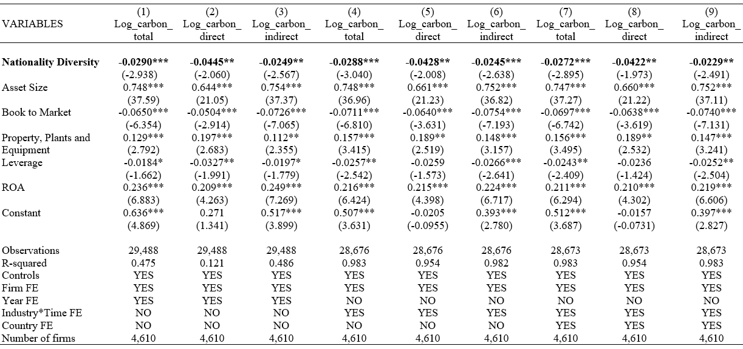
Result : Higher TMT nationality diversity contributes to lower carbon emission level and carbon intensity
The effect of TMT nationality diversity on corporate carbon emissions (level)
8
Future improvement
Result
Theoretical Framework
Result
Result
Theoretical Framework
Data & Method
Result
Hypothesis
Motivation
Hypothesis
Main question
Main question
Main question
Framework & Hypothesis
Contribution
Contribution
Contribution
Contribution
Literature
Literature
Literature
Conclusion
Data & method
Data & method
Data & Method
Conclusion
Future improvement

Slide 13
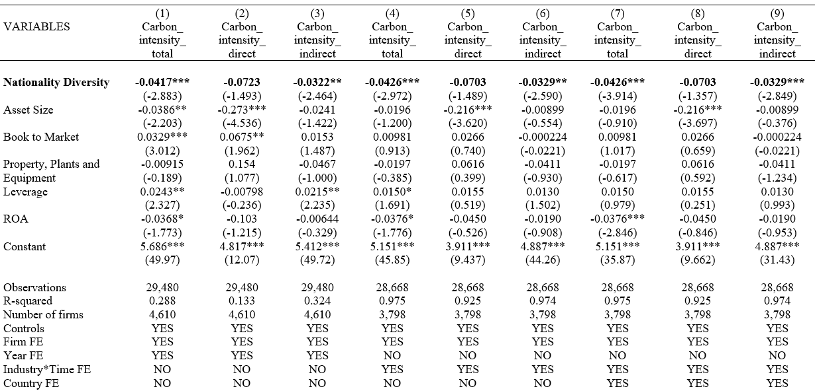
In economic terms, increasing nationality diversity by one standard deviation is associated with a 1.02% reduction in direct carbon emissions. This decrease is roughly one-third of the median annual growth rate in direct carbon emissions around the world.
The effect of TMT nationality diversity on corporate carbon emissions (intensity)
9
Future improvement
Result
Theoretical Framework
Result
Result
Theoretical Framework
Data & Method
Result
Hypothesis
Motivation
Hypothesis
Main question
Main question
Main question
Framework & Hypothesis
Contribution
Contribution
Contribution
Contribution
Literature
Literature
Literature
Conclusion
Data & method
Data & method
Data & Method
Conclusion
Future improvement

Slide 14
Evidence from Diversity Disclosure Requirement, Regulation S-K in 2009
Identification strategy
The Securities and Exchange Commission (SEC) issued Regulation S-K (Item 407(c)(2)(vi)) in 2009, requiring corporate boards to disclose in their proxy statements whether, and if so how, the nominating committee considers diversity in identifying director nominees.
This regulation acts as an exogenous shock, introducing variation in TMT nationality diversity.
This will affect all public U.S. firm (treated group) while firms in other countries are not directly affected (control group)
Studies, such as Kang, Kim, and Oh (2022), have utilized this regulation to analyze the impact of this regulation to the diversity.
10
Future improvement
Result
Theoretical Framework
Result
Result
Theoretical Framework
Data & Method
Result
Hypothesis
Motivation
Hypothesis
Main question
Main question
Main question
Framework & Hypothesis
Contribution
Contribution
Contribution
Contribution
Literature
Literature
Literature
Conclusion
Data & method
Data & method
Data & Method
Conclusion
Future improvement

Slide 15

Evidence from Diversity Disclosure Requirement, Regulation S-K in 2009
Identification strategy
Difference-in-difference model
Y_{i,t} = 𝛼 + β₁Treat_{i} × Post_{i,t} + $\sum_{k=2}^{n}{β}$_{k}(Control)_{i,t} + FE + ε_{i,t}
Y_{i,t} represents nationality diversity, and carbon emission.
Propensity score matching selects control firms matching treated firms based on pre-regulation firm characteristics.
Post_{i,t} is equal to one for the period following 2008
Treated firms are all public US firms affected by the diversity mandate; control firms are from other countries unaffected.
11
Future improvement
Future improvement
Result
Theoretical Framework
Result
Result
Theoretical Framework
Data & Method
Result
Hypothesis
Motivation
Hypothesis
Main question
Main question
Main question
Framework & Hypothesis
Contribution
Contribution
Contribution
Contribution
Literature
Literature
Literature
Conclusion
Data & method
Data & method
Data & Method
Conclusion
Future improvement

Slide 16
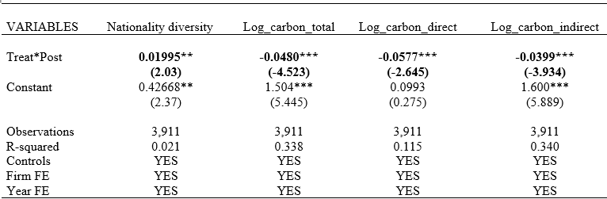
Evidence from Diversity Disclosure Requirement, Regulation S-K in 2009
DID result
12
Future improvement
Future improvement
Result
Theoretical Framework
Result
Result
Theoretical Framework
Data & Method
Result
Hypothesis
Motivation
Hypothesis
Main question
Main question
Main question
Framework & Hypothesis
Contribution
Contribution
Contribution
Contribution
Literature
Literature
Literature
Conclusion
Data & method
Data & method
Data & Method
Conclusion
Future improvement

Slide 17
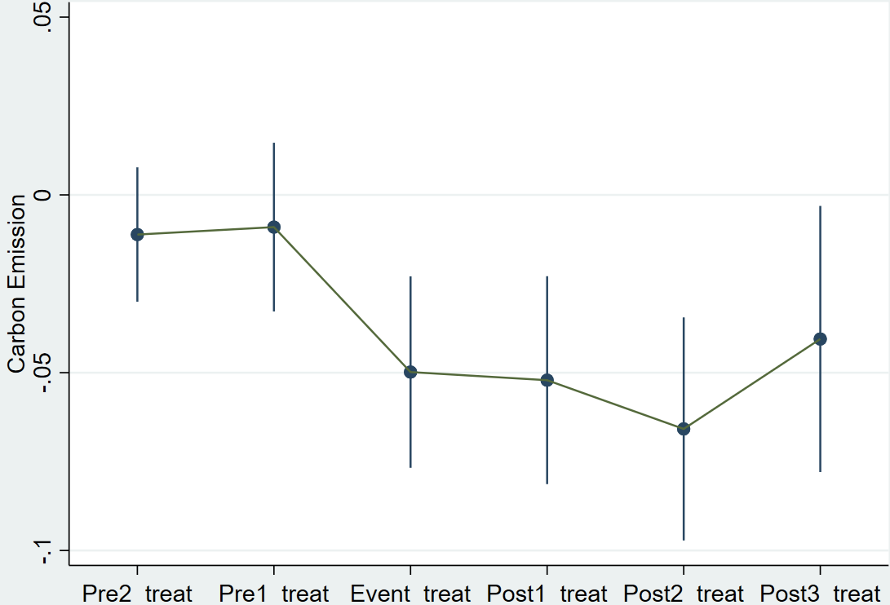
No discernible trend in carbon emissions before the diversity disclosure mandates in 2009 and we observe a significant change in carbon emissions between the treatment and control groups after the diversity disclosure mandates, .
A parallel trend analysis
13
Future improvement
Result
Theoretical Framework
Result
Result
Theoretical Framework
Data & Method
Result
Hypothesis
Motivation
Hypothesis
Main question
Main question
Main question
Framework & Hypothesis
Contribution
Contribution
Contribution
Contribution
Literature
Literature
Literature
Conclusion
Data & method
Data & method
Data & Method
Conclusion
Future improvement

Slide 18

Evidence from CEO Death
Identification strategy
Difference-in-difference model
Y_{i,t} = 𝛼 + β₁Treat_{i} × After_{i,t} + $\sum_{k=2}^{n}{β}$_{k}(Control)_{i,t} + FE + ε_{i,t}
Y_{i,t} represents nationality diversity, and carbon emission.
Treat_{i} is equal to one for the treated firms that has experienced CEO death and zero otherwise.
After_{i,t} is equal to one for the period following the firm CEO death event.
14
Future improvement
Result
Theoretical Framework
Result
Result
Theoretical Framework
Data & Method
Result
Hypothesis
Motivation
Hypothesis
Main question
Main question
Main question
Framework & Hypothesis
Contribution
Contribution
Contribution
Contribution
Literature
Literature
Literature
Conclusion
Data & method
Data & method
Data & Method
Conclusion
Future improvement

Slide 19
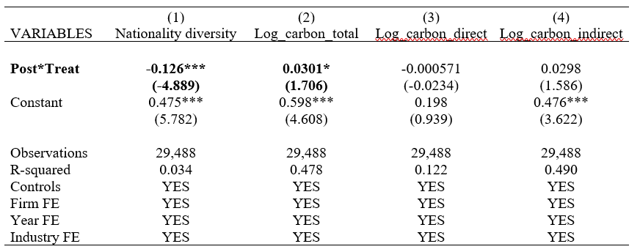
Evidence from CEO Death : after the CEO's death, TMT nationality diversity decreases and there is a significant increase in carbon emissions levels or priorities related to environmental practices.
Identification strategy result
15
Future improvement
Future improvement
Result
Theoretical Framework
Result
Result
Theoretical Framework
Data & Method
Result
Hypothesis
Motivation
Hypothesis
Main question
Main question
Main question
Framework & Hypothesis
Contribution
Contribution
Contribution
Contribution
Literature
Literature
Literature
Conclusion
Data & method
Data & method
Data & Method
Conclusion
Future improvement

Slide 20
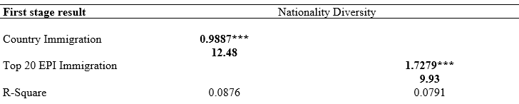
Evidence from Instrumental Variable (IV) Test using country immigration percentage
Identification strategy
2SLS model
Immigration policies influence diversity practices within organizations, potentially affecting leadership demographics (Lauring & Selmer, 2010).
Use country immigration percentages from all countries and from the top 20 countries in the Environmental Performance Index (EPI)
20
Future improvement
Result
Theoretical Framework
Result
Result
Theoretical Framework
Data & Method
Result
Hypothesis
Motivation
Hypothesis
Main question
Main question
Main question
Framework & Hypothesis
Contribution
Contribution
Contribution
Contribution
Literature
Literature
Literature
Conclusion
Data & method
Data & method
Data & Method
Conclusion
Future improvement

Slide 21
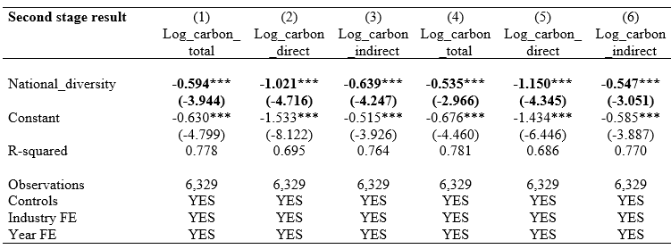
Coefficients in all model specifications in second stage are negative and statistically significant at the 1% level, with an R-squared of around 0.7.
Identification strategy
2SLS model
_{t}
21
Future improvement
Result
Theoretical Framework
Result
Result
Theoretical Framework
Data & Method
Result
Hypothesis
Motivation
Hypothesis
Main question
Main question
Main question
Framework & Hypothesis
Contribution
Contribution
Contribution
Contribution
Literature
Literature
Literature
Conclusion
Data & method
Data & method
Data & Method
Conclusion
Future improvement

Slide 22
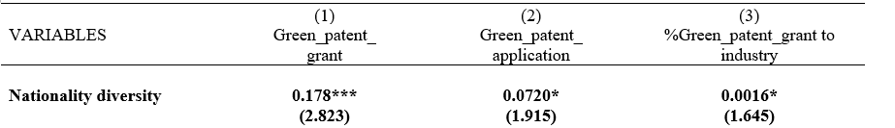
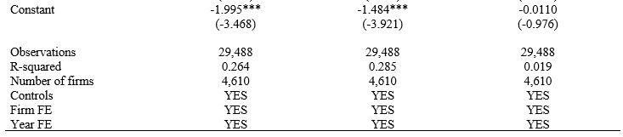
Result : TMT members that are from abroad bring more green innovation to the firm.
The Underlying Mechanism
Green innovation
16
Future improvement
Result
Theoretical Framework
Result
Result
Theoretical Framework
Data & Method
Result
Hypothesis
Motivation
Hypothesis
Main question
Main question
Main question
Framework & Hypothesis
Contribution
Contribution
Contribution
Contribution
Literature
Literature
Literature
Conclusion
Data & method
Data & method
Data & Method
Conclusion
Future improvement

Slide 23
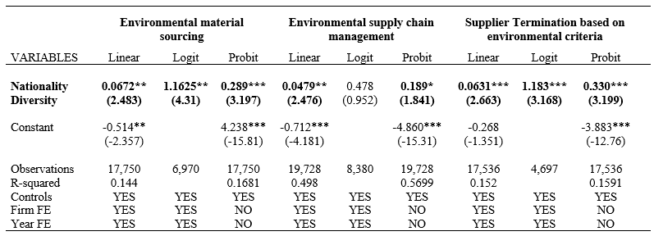
Result
: Firms with higher TMT nationality diversity enhance green operation and environmental practices with suppliers
The Underlying Mechanism
Green Operation and Supply Chain Management
17
Future improvement
Result
Theoretical Framework
Result
Result
Theoretical Framework
Data & Method
Result
Hypothesis
Motivation
Hypothesis
Main question
Main question
Main question
Framework & Hypothesis
Contribution
Contribution
Contribution
Contribution
Literature
Literature
Literature
Conclusion
Data & method
Data & method
Data & Method
Conclusion
Future improvement

Slide 24
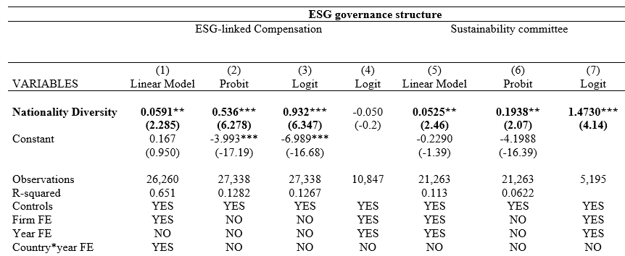
Result
: Firms with higher TMT nationality diversity are more likely to prioritize ESG considerations in governance structures.
The Underlying Mechanism
Sustainable Corporate Governance Structure and Shareholder Demand
18
Future improvement
Result
Theoretical Framework
Result
Result
Theoretical Framework
Data & Method
Result
Hypothesis
Motivation
Hypothesis
Main question
Main question
Main question
Framework & Hypothesis
Contribution
Contribution
Contribution
Contribution
Literature
Literature
Literature
Conclusion
Data & method
Data & method
Data & Method
Conclusion
Future improvement

Slide 25
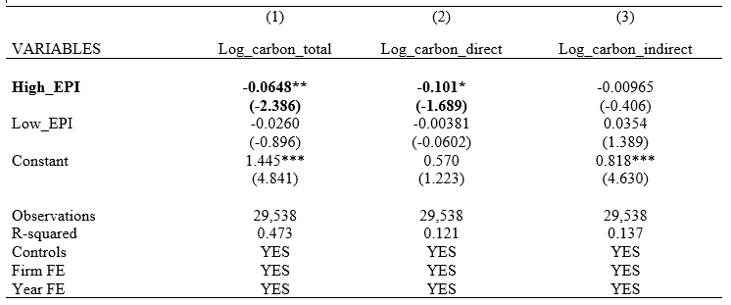
Result
: The effect of TMT in reducing carbon emissions is stronger for firms with top managers originating from countries with higher environmental performance.
The Underlying Mechanism
Heterogeneity in TMT Characteristic
25
Future improvement
Future improvement
Result
Theoretical Framework
Result
Result
Theoretical Framework
Data & Method
Result
Hypothesis
Motivation
Hypothesis
Main question
Main question
Main question
Framework & Hypothesis
Contribution
Contribution
Contribution
Contribution
Literature
Literature
Literature
Conclusion
Data & method
Data & method
Data & Method
Conclusion
Future improvement

Slide 26

Conclusion
TMT nationality diversity leads greener corporation.
Result shaped by countries leading in sustainability.
This TMT diversity contribute to
Green innovation.
Sustainable corporate governance practices.
Sustainable operation and supply chain management.
27
Future improvement
Result
Theoretical Framework
Result
Result
Theoretical Framework
Data & Method
Result
Hypothesis
Motivation
Hypothesis
Main question
Main question
Main question
Framework & Hypothesis
Contribution
Contribution
Contribution
Contribution
Literature
Literature
Literature
Conclusion
Data & method
Data & method
Data & Method
Conclusion
Future improvement

Slide 27

Future Improvement
Next steps
Measurement of diversity (e.g., Herfindahl-Hirschman Index (HHI))
External validity depending on institutional contexts (national laws, regulatory strictness, or cultural norms)
Sectoral analyses
Intersection of nationality diversity with other forms of diversity.
27
Main question
Literature
Contribution
Data & Method
Result
Conclusion
Future improvement

Slide 28
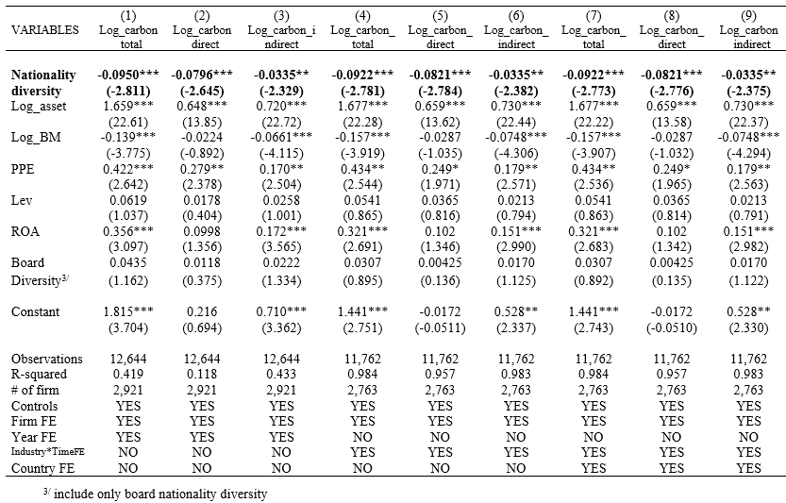
Result : Higher TMT nationality diversity contributes to lower carbon emission level even control for board diversity
1
The effect of TMT nationality diversity on corporate carbon emissions, with control for board diversity
The Underlying Mechanism
12
Main question
Literature
Contribution
Data & Method
Result
Conclusion
Future improvement

Slide 29
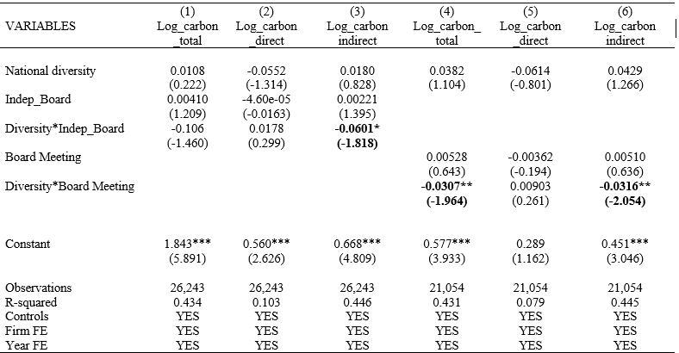
Result
: The effect of board characteristics in reducing carbon emissions is stronger for firms with a higher number of independent board of directors and more frequent meetings.
The effect of variation in board characteristics to corporate carbon emissions
3B
Board characteristic (Independence/frequency of board meetings)
26
Main question
Literature
Contribution
Data & Method
Result
Conclusion
Future improvement

